Slide 1


Cloud Web Services
Module: 01
Introduction to Cloud Computing and Amazon web services

Slide 2
Introduction to Cloud Computing and Amazon web services
AIM:
The aim of this module is to introduce students about cloud computing and Amazon web services.
2

Slide 3

Introduction to Cloud Computing and Amazon web services
Objectives:
The objectives of this module are:
Explain Cloud Computing and the need for cloud
Outline the history of Cloud Computing
Describe the various cloud deployment models
Explain different types of clouds
Explain the business value of Cloud Computing and Amazon web services
3

Slide 4
Introduction to cloud computing and Amazon web services
Outcome:
At the end of this module, you are expected to:
Explain Cloud Computing and its advantages
Describe cloud deployment models
Concept and uses of Amazon web services
Recognise the business applications of cloud
4

Slide 5

Introduction to cloud computing and Amazon web services
Contents
What is cloud computing?
Uses of cloud computing
Cloud computing architecture
Difference between cloud computing and distributed system
Advantages and disadvantages of cloud computing
Different service model of cloud computing
Different types of clouds
Cloud security
How to create a free tier AWS account?
Introduction to AWS and computing services
5

Slide 6
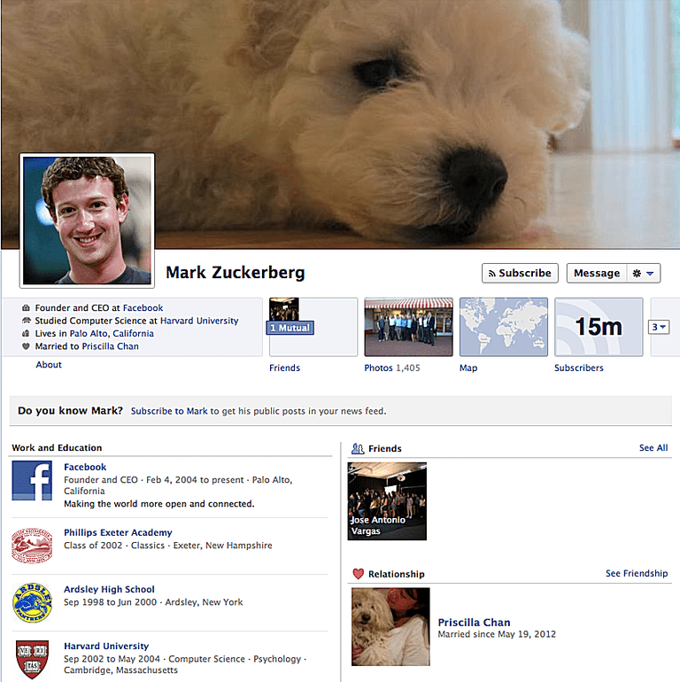
Introduction to Cloud Computing and Amazon web services
Have you uploaded photos and videos on Facebook?
6

Slide 7

Introduction to Cloud Computing and Amazon web services
Have you accessed the photos that you uploaded on Facebook in the past?
Where are the photos and videos we uploaded on Facebook stored?
7

Slide 8
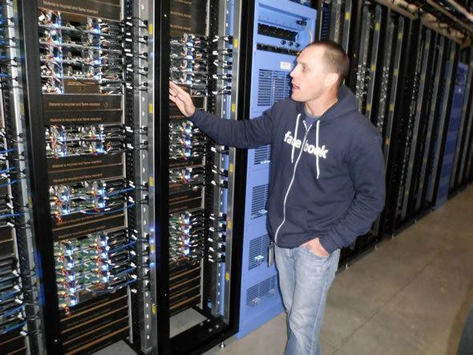
Introduction to Cloud Computing and Amazon web services
All the data are stored on Facebook servers located all across the globe.

Slide 9

Introduction to Cloud Computing and Amazon web services
Similarly, we access Gmail, LinkedIn and other social media applications.
All we need is a password and if we can get to the internet
No.
through any device we
can access our data.
So, there is no need to store anything?
9

Slide 10


Introduction to Cloud Computing and Amazon web services
To understand why cloud computing is needed, consider this as an example; we all have used Uber or Ola services at least once.
What is the advantage of using these services over buying a car?
VS.
Own car
10

Slide 11
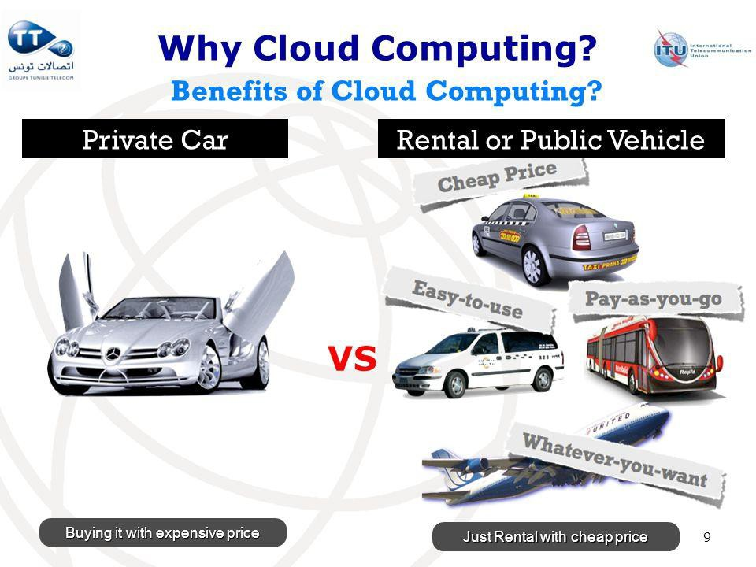
Introduction to Cloud Computing and Amazon web services
Buying a car requires investment, driving ourselves or hiring a chauffeur, parking space and maintenance.
Cloud computing services such as Uber or Ola is like renting a car. No parking space required, no maintenance and you pay by miles.
11

Slide 12
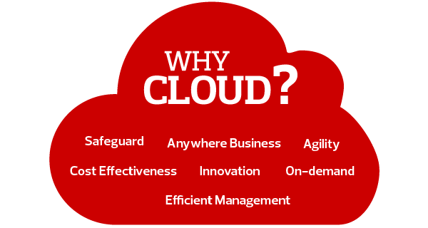
Introduction to Cloud Computing and Amazon web services
Why Cloud?
12

Slide 13
Introduction to Cloud Computing and Amazon web services
Why Cloud?
Cloud provides a host of benefits which make it so popular.
We can not only store large amounts of data securely on the cloud, but it is also possible to rent the latest hi- tech software and even hardware.
For example:
Consider that you are using a traditional method of computing in your office. If your company recruits some more employees, then you need to do all the hardware as well as software setup for all those employees again, which will inevitably increase your expenses.
However, using cloud computing, you get the platform on rent and simply provide the employees a terminal and credentials to logon to their virtual system. Hence, in this case, you rent the processing time, memory and the software setup.
Whenever an employee quits, his resources are freed and there is no need to pay for those rentals.
13

Slide 14
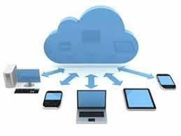
Introduction to Cloud Computing and Amazon web services
What is Cloud?
The cloud itself is a set of hardware, networks, storage, services and interfaces that enable the delivery of
computing as a service.
Cloud Computing – Definition:
Cloud Computing is the on-demand delivery of computer power, infrastructure, applications, storage and other IT resources through a cloud services platform via the internet with pay-as-you-go pricing.
14

Slide 15
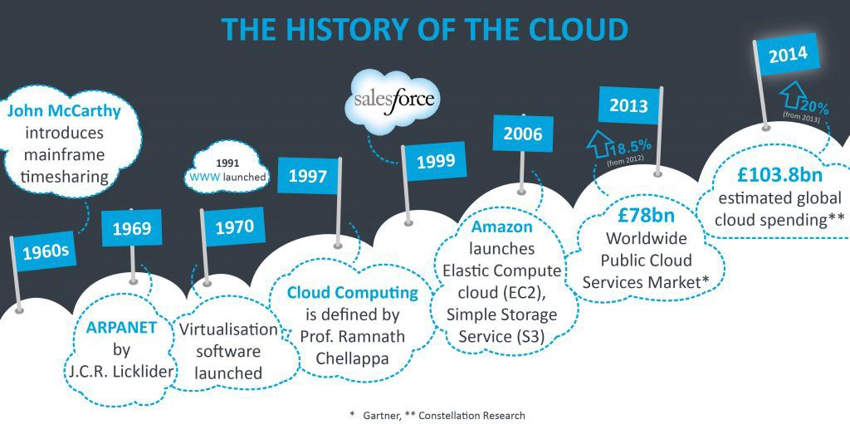
Introduction to Cloud Computing and Amazon web services
History of Cloud Computing
15

Slide 16
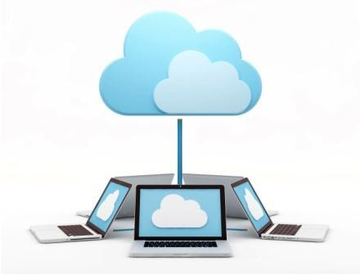
Introduction to Cloud Computing and Amazon web services
History of Cloud Computing
The origin of cloud can be traced as far back as 1950s when John McCarthy, a computer scientist, introduced ‘theory of time sharing’.
In the 1960s, J.C.R. Licklider developed the ARPANET (Advanced Research
Projects Agency Network) which formed the basis of today’s internet.
The development of virtual machines in 1970s enabled users to run multiple
operating systems on a single machine.
In 1991, the World Wide Web emerged.
16

Slide 17
Introduction to Cloud Computing and Amazon web services
History of Cloud Computing
The 1990s also saw a shift from point-to-point data circuits to virtual private network services being offered by telecommunication companies. This resulted in increased bandwidth at a lower cost.
In 1997, the first definition of cloud computing was given by Professor Ramnath Chellapa of Emory University. He defined Cloud Computing as,
‘Computing paradigm where the boundaries of computing will be determined by economic rationale rather than technical limits alone.’
17

Slide 18

Introduction to Cloud Computing and Amazon web services
History of Cloud Computing
Major Milestones:
1999: Salesforce.com
Established the ability to use a simple website on the Internet to deliver enterprise-level applications.
2002: Amazon Web Services
Featured several cloud-based retail services which included data storage and computation.
2006: Amazon’s Elastic Compute Cloud (EC2) – the first commercial cloud
Enabled small companies to rent computers that would host and run their own applications.
18

Slide 19
Introduction to Cloud Computing and Amazon web services
History of Cloud Computing
Major Milestones:
2007: Dropbox
MIT student created this file-hosting service that offers file storage and synchronization.
2009:
Google Apps – example of browser-based enterprise applications.
Windows Azure – Microsoft’s cloud computing platform.
19

Slide 20
Introduction to Cloud Computing and Amazon web services
Types of clouds
Four Cloud Deployment Models: Deployment models describe the ways with which the cloud services can be deployed or made available to its customers, depending on the organizational structure and the provisioning location. Four deployment models are usually distinguished, namely, public, private, community, and hybrid cloud service usage:
Private cloud: The cloud infrastructure is provisioned for exclusive use by a single organization comprising multiple consumers (e.g., business units). It may be owned, managed, and operated by the organization, a third party, or some combination of them, and it may exist on or off premises.
Public cloud: The cloud infrastructure is provisioned for open use by the general public. It may
be owned, managed, and operated by a business, academic, or government organization, or some
combination of them. It exists on the premises of the cloud provider.
20

Slide 21
Introduction to Cloud Computing and Amazon web services
Types of clouds
Community cloud: The cloud infrastructure is shared by several organizations and supports a specific community that has shared concerns (e.g., mission, security requirements, policy, and compliance considerations). It may be managed by the organizations or a third party and may exist on premise or off premise.
Hybrid cloud: The cloud infrastructure is a composition of two or more distinct cloud infrastructures (private, community, or public) that remain unique entities but are bound together by standardized or proprietary technology that enables data and application portability (e.g., cloud bursting for load balancing between clouds).
21

Slide 22
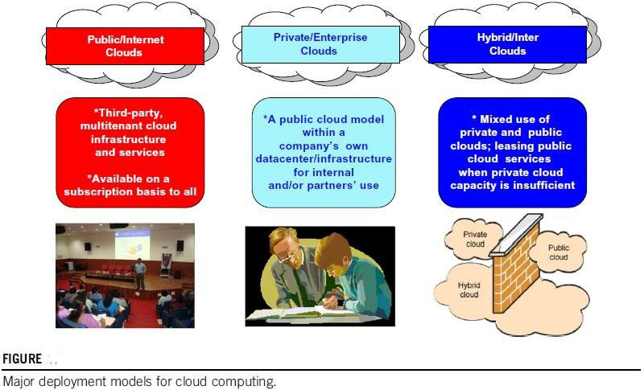
Introduction to Cloud Computing and Amazon web services
Types of clouds
22

Slide 23
Introduction to Cloud Computing and Amazon web services
Types of clouds
Three Service Offering Models
The three kinds of services with which the cloud-based computing resources are available to end customers are as follows: Software as a Service (SaaS), Platform as a Service (PaaS), and Infrastructure as a Service (IaaS). It is also known as the software–platform–infrastructure (SPI) model of the cloud.
SaaS
PaaS
IaaS
23

Slide 24
Introduction to Cloud Computing and Amazon web services
Types of clouds
Three Service Offering Models SaaS
The capability provided to the consumer is to use the provider’s applications running on a cloud infrastructure, including network, servers, operating systems, storage, and even individual application capabilities, with the possible exception of limited user-specific application configuration settings.
The applications are accessible from various client devices, either through a thin client interface,
such as a web browser (e.g., web-based e-mail), or a program interface.
The consumer does not manage or control the underlying cloud infrastructure.
24

Slide 25
Introduction to Cloud Computing and Amazon web services
Types of clouds
PaaS
The capability provided to the consumer is to deploy onto the cloud infrastructure consumer- created or acquired applications created using programming languages, libraries, services, and tools supported by the provider.
The consumer does not manage or control the underlying cloud infrastructure, but has control over the deployed applications and possible configuration settings for the application-hosting environment.
In other words, it is a packaged and ready-to-run development or operating framework.
The PaaS vendor provides the networks, servers, storage and manages the levels of scalability and maintenance.
25

Slide 26
Introduction to Cloud Computing and Amazon web services
Types of clouds
IaaS
The capability provided to the consumer is to provision processing, storage, networks, and other fundamental computing resources on a pay-per-use basis where he or she is able to deploy and run arbitrary software, which can include operating systems and applications.
The consumer does not manage or control the underlying cloud infrastructure but has control over the operating systems, storage, and deployed applications and possibly limited control of select networking components (e.g., host firewalls).
The service provider owns the equipment and is responsible for housing, cooling operation, and
maintenance.
26

Slide 27
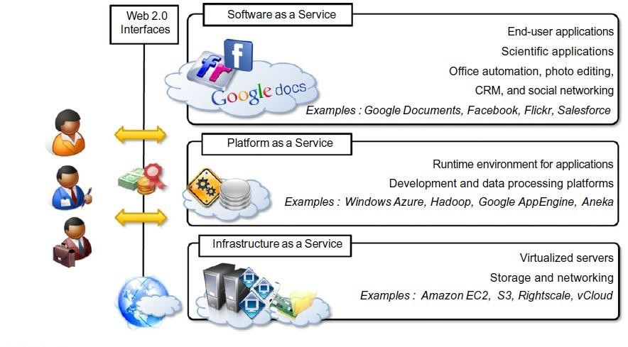
Introduction to Cloud Computing and Amazon web services
Types of clouds
27

Slide 28
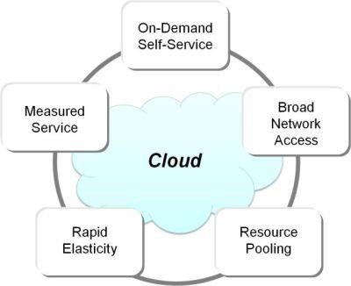
Introduction to Cloud Computing and Amazon web services
Characteristics of Cloud Computing
On-demand Service
Broad Network Service
Resource Pooling
Rapid Elasticity
Measured Service
28

Slide 29
Introduction to Cloud Computing and Amazon web services
Characteristics of Cloud Computing
On-demand Service: The user can provide the required resources automatically without human intervention.
Broad Network Access: Accessible from any of the consumer’s devices (such as Mobile, tablet, laptop and Desktop).
Resource Pooling: Multiple consumers can use multiple physical and virtual resources dynamically assigned and reassigned according to their demand.
Rapid Elasticity: Capabilities can be provisioned elastically. They can be scaled up-and- down based on the consumer’s demand.
Measured Service: The service is measured using the pay-as-you-go pricing model.
29

Slide 30




Introduction to Cloud Computing and Amazon web services
Cloud Services – Pyramid
Model:
NIST defines three service
models: SaaS, Paas and IaaS.
SaaS – Software as a Service
SaaS
The figure depicts their relationship as a hierarchical model with each layer
PaaS
PaaS – Platform as a Service
consuming elements of the layers below it.
IaaS – Infrastructure as a Service
IaaS
9

Slide 31
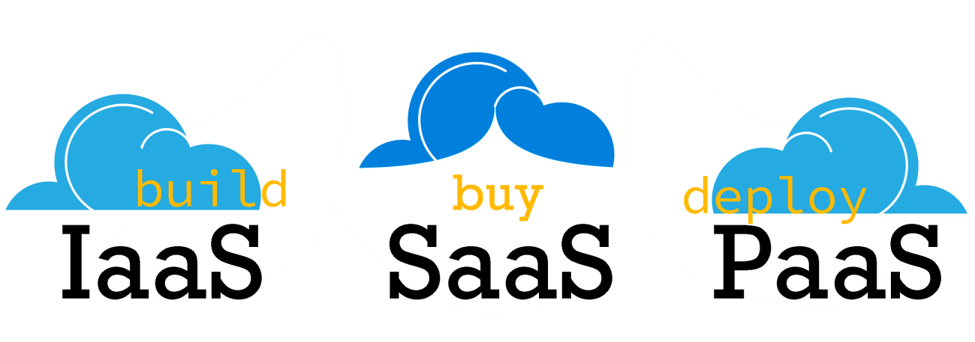
Introduction to Cloud Computing and Amazon web services
Cloud Service Models
Cloud resources can be consumed by:
Other cloud services
Traditional electronic devices
Users using web browsers
IaaS is at the fundamental level which includes services such as networking, storage and other
architectural elements for system administrator and enterprise planners.
Application developers consume services at PaaS level.
The applications developed are consumed by the users at the SaaS level.
31

Slide 32
Introduction to Cloud Computing and Amazon web services
Users
Apps
Application Developers
Platform
System Admins
Infrastructure
What is found at each level?
Who consumes each level?
32

Slide 33
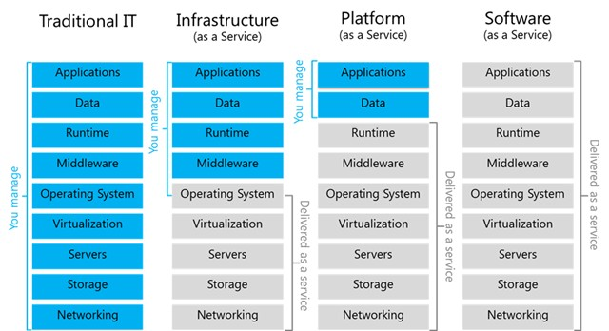
Introduction to Cloud Computing and Amazon web services
Traditional IT vs. Cloud Services Models
33

Slide 34
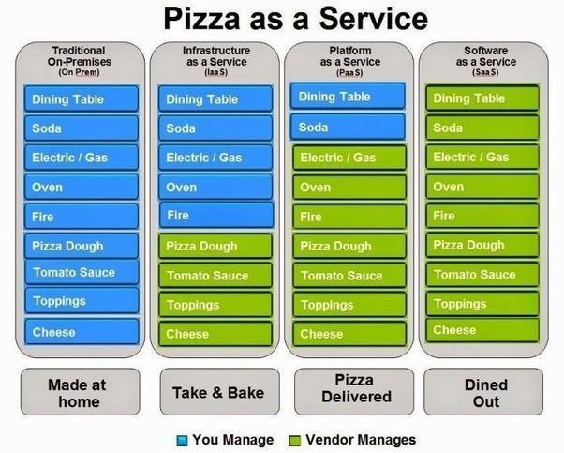
Introduction to Cloud Computing and Amazon web services
Traditional IT vs. Cloud Services Model – Pizza Analogy
34

Slide 35
Introduction to Cloud Computing and Amazon web services
Infrastructure as a Service
35

Slide 36
Introduction to Cloud Computing and Amazon web services
IaaS
Platform Virtualization
Service Level Agreement (SLA)
IaaS Networking
Virtual Private Cloud
IaaS Storage
IaaS Security
Cloud Data Protection
Cloud Pricing
Cloud Migration
IaaS Benefits and Risks
IaaS Examples
36

Slide 37
Introduction to Cloud Computing and Amazon web services
Why do companies rent external infrastructure?
There are four reasons:
Price – renting is cheaper.
Aggregation of Resources – helps in scaling the resources up-or-down.
Speed of Deployment – no overhead of maintenance means faster deployment of products.
Security – service providers take care of security issues such as Denial of service attacks.
37

Slide 38
Introduction to Cloud Computing and Amazon web services
Overview of Infrastructure as a Service:
Infrastructure as a Service is also called as Hardware as a Service (HaaS).
Virtualized resources (CPU, memory, storage and eventually service substrates) are used (on a pay per use basis) by applications.
IaaS helps you avoid the expense and complexity of buying and managing your own physical servers and other data center infrastructure. Each resource is offered as a separate service component and you only need to rent a particular one for as long as you need it.
Currently, the most high-profile IaaS operation is Amazon’s Elastic Compute Cloud (Amazon EC2). It provides a Web interface that allows customers to access virtual machines. EC2 offers scalability under the user’s control with the user paying for resources by the hour.
38

Slide 39
Introduction to Cloud Computing and Amazon web services
Common IaaS Business Scenarios
Businesses use IaaS for:
Test and Development: test environments can be quickly setup and dismantled as a result of which new applications can be brought to the market faster.
Web Hosting: using IaaS for web hosting is less expensive.
Storage, Backup and Recovery: the need for physical storage can effectively be eliminated, as IaaS is useful in handling unpredictable demand in storage requirements.
High-Performance Computing: using super computers for highly complex computing such as earthquake simulations.
Big Data Analysis: mining large amounts of data sets to analyse and find useful patterns within, that
requires huge processing, which IaaS can provide economically.
39

Slide 40
Introduction to Cloud Computing and Amazon web services
Virtualization:
Virtualization is a fundamental mechanism for delivering cloud services.
Virtualization refers to the creation of a virtual resource such as a server, desktop, operating system, file, storage or network.
The main goal of virtualization is to manage workloads by radically transforming traditional computing to make it more scalable.
The most common form of virtualization is the operating system-level virtualization. In operating system-level virtualization, it is possible to run multiple operating systems on a single piece of hardware. Virtualization technology involves separating the physical hardware and software by emulating hardware using software. When a different OS is operating on top of the primary OS by means of virtualization, it is referred to as a virtual machine.
A virtual machine is nothing but a data file on a physical computer that can be moved and copied to another computer, just like a normal data file.
40

Slide 41
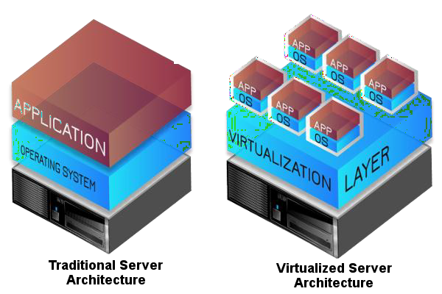
Introduction to Cloud Computing and Amazon web services
Virtualization:
Virtualization provides a platform for optimizing complex IT resources in a scalable manner (efficiently
growing), which is ideal for delivering services.
41

Slide 42

Introduction to Cloud Computing and Amazon web services
Characteristics of Virtual Machines:
Virtualization has three characteristics that make it ideal for cloud computing:
Partitioning: In virtualization, many applications and operating systems (OS) are supported in a single
physical system by partitioning (separating) the available resources.
Isolation: Each virtual machine is isolated from its host physical system and other virtualized machines. Because of this isolation, if one virtual instance crashes, it does not affect the other virtual machines. In addition, data is not shared between one virtual container and another.
Encapsulation: A virtual machine can be represented (and even stored) as a single file, so that you can easily identify it based on the service it provides. In essence, the encapsulated process could be a business service. This encapsulated virtual machine can be presented to an application as a complete entity. Therefore, encapsulation can protect each application, so that it does not interfere with another application.
42

Slide 43

Introduction to Cloud Computing and Amazon web services
Using a Hypervisor in Virtualization:
A hypervisor is an operating system, which makes things happen in an orderly manner. The hypervisor sits at the lowest levels of the hardware environment.
Because in cloud computing, you need to support different operating environments. Thus, the hypervisor
becomes an ideal delivery mechanism.
The hypervisor lets you show the same application on lots of systems without having to physically copy that application onto each system.
It is designed like a mainframe OS rather than the Windows operating system.
The hypervisor, therefore, schedules the amount of access, everything that guest OSes have to, from the CPU, to memory, to disk I/O and to any other I/O mechanisms.
With virtualization technology, you can set up the hypervisor to split the physical computer’s resources.
43

Slide 44
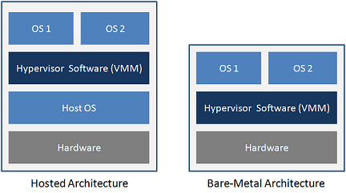
Introduction to Cloud Computing and Amazon web services
Types of Hypervisor:
Different hypervisors support different aspects of the cloud. Hypervisors come in several types:
Native hypervisors, which sit directly on the hardware platform, are most likely used to gain better performance for individual users.
Hosted hypervisors run as a distinct software layer above both the hardware and the OS. This type of hypervisor is useful both in private and in public clouds to gain performance improvements.
Embedded hypervisors are integrated into a processor on a separate chip. Using this type of hypervisor, a service provider gains performance improvements.
44

Slide 45
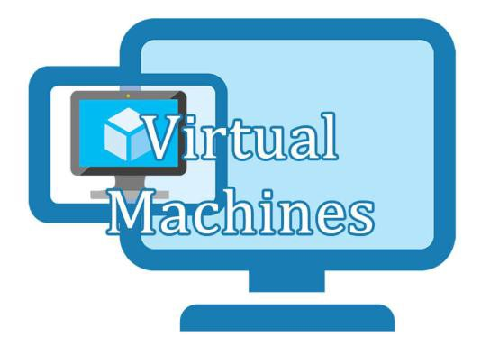
Introduction to Cloud Computing and Amazon web services
Virtualization Benefits:
Virtualization offers many practical benefits, including the following:
New systems can be setup easily.
No need to invest in hardware for testing and debugging setups.
The capability to recover quickly from system corruption.
Relocating and migrating systems with ease. For example, moving to a more powerful machine can simply be a matter of taking a snapshot of a virtual machine and starting up a new virtual machine based on that snapshot.
The ease of remote management. Physical access to data centers is tightly controlled these days. The use of virtual machines greatly reduces the need for physical access.
Multiple operating systems can be run simultaneously on one server.
45

Slide 46
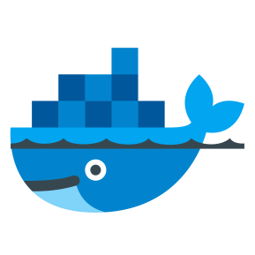
Introduction to Cloud Computing and Amazon web services
Containers:
Containers are an alternative to Virtual Machines (VMs) used in cloud computing.
A container is designed to virtualize a single application instead of the entire operating system.
For example, if you have a MySQL container, it provides a virtual instance of the application and that is all it does.
Containers create an isolation at application level, rather than at server level. Therefore, any issues like over consumption of resources by a process affects only that container and not the whole VM.
46

Slide 47
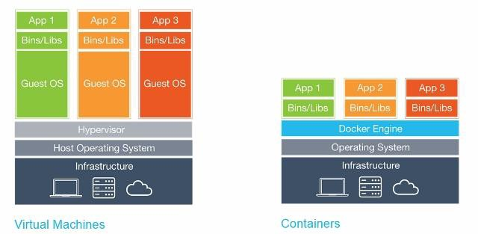
Introduction to Cloud Computing and Amazon web services
Virtual Machines vs Containers:
Instead of virtualizing the BIOS and hardware like a virtual machine, containers operate on top of a shared
operating system.
However, because containers do not need to utilize the extra hardware required to run their own operating systems, you can run as many as 4× or 6 × the number of containers more than VMs.
47

Slide 48
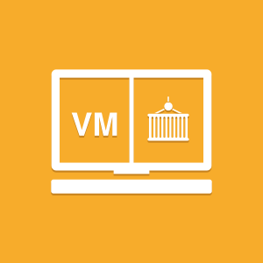
Introduction to Cloud Computing and Amazon web services
Advantages of Containers over Virtual Machines:
Containers can initiate in milliseconds compared with VMs which initiate in minutes.
Containers use less resources resulting in faster performance than VMs.
The ability to operate more containers in the same amount of space taken by a VM.
Disadvantages of Containers:
Containers can be harder to manage than VMs, especially when there is a large number of containers.
Containers are less secure than VMs as each container can be a potential attack surface depending on permissions given to the app.
48

Slide 49

Introduction to Cloud Computing and Amazon web services
Service Level Agreement (SLA)
Think of building a new home or buying a new car, we expect to have a blueprint for the house or warranty to be given with the purchase of the new car.
A service level agreement (SLA) serves as both a blueprint and warranty for cloud computing.
An SLA is a contract between a service provider (either internal or external) and the end user that defines the level of service expected from the service provider.
SLAs define what the customer will receive, not how the service itself is provided or delivered.
A telecom company's SLA for example, may promise network availability of 99.999 percent (that works out to about five and a quarter minutes of downtime per year, which can still be too long for some businesses), and allow the customer to reduce their payment by a given percentage if it is not achieved usually based on the magnitude of the breach.
32

Slide 50
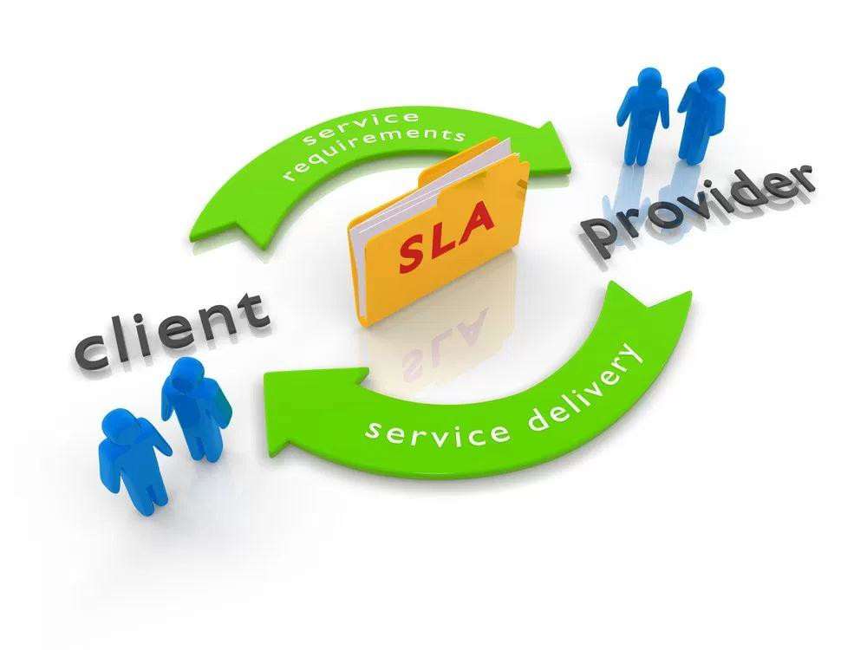
Introduction to Cloud Computing and Amazon web services
Service Level Agreement (SLA)
Every company that buys any service from a cloud service provider must either accept a standard service level agreement (SLA) from the provider or negotiate such an agreement.
No organization should commit mission-critical systems to the cloud without negotiating an SLA that includes significant penalties for not delivering the promised service level.
IT and the service provider must work together to establish these SLAs.
Typical SLAs include the following:
Response times (possibly varying by transaction)
Availability on any given day
Overall uptime target
Agreed-on response times and procedures in the event a service goes down
32

Slide 51
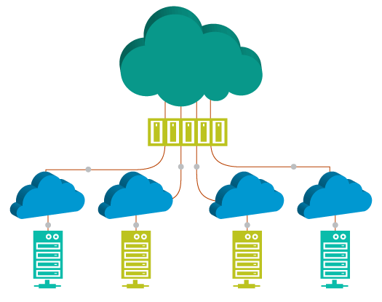
Introduction to Cloud Computing and Amazon web services
Virtual Private Cloud
A virtual private cloud (VPC) is a hybrid model of cloud computing in which a private cloud solution is provided within a public cloud provider’s infrastructure.
VPC is a cloud computing service in which a public cloud provider isolates a specific portion of their public cloud infrastructure to be provisioned for private use. The VPC infrastructure is managed by a public cloud vendor; however, the resources allocated to a VPC are not shared with any other customer.
VPC are specifically for those who want to benefit from cloud yet have some concerns about privacy, security and loss of control over proprietary data.
VPC customers are given dedicated cloud servers, virtual networks, cloud storage and private ID
addresses.
Examples for VPCs include Amazon VPC and Google App Engine.
51

Slide 52
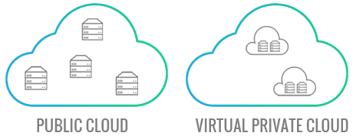
Introduction to Cloud Computing and Amazon web services
Benefits of Virtual Private Cloud
Bandwidth Efficiency
Application Performance
Security
52

Slide 53
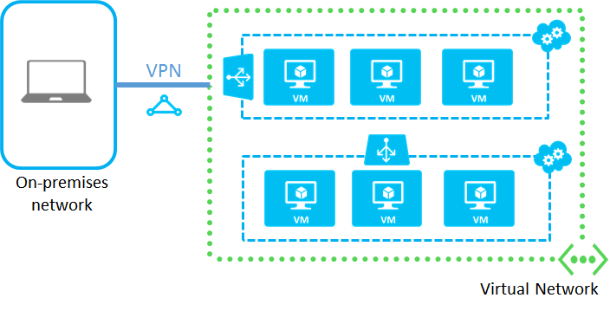
Introduction to Cloud Computing and Amazon web services
IaaS Networking
53

Slide 54
Introduction to Cloud Computing and Amazon web services
IaaS Networking
Network resources can be virtualized just like other cloud resources. To do this, a cloud uses virtual
switches to separate a physical network into logical partitions.
A virtual network is like a LAN. It is an isolated address space that can be divided into automatically routed subnets.
Virtual LANS (VLANs) can act as an extension of the enterprise’s private network. You can connect to it via an encrypted Virtual Private Network (VPN) connection.
A hypervisor can share a single physical network interface with multiple virtual machines. Each virtual
machine has one or more virtual network interfaces.
54

Slide 55

Introduction to Cloud Computing and Amazon web services
IaaS Storage overview
IaaS storage can be very complex. It involves creating a resource pool which may include virtualized storage and tie it up with orchestration, to support cloud requirements such as moving running VMs between servers and taking instant snapshots of multi-terabyte virtual drives.
Networked storage services are generally classified in the way they are consumed and interfaced with
on the client side. The thee types of storage are:
File storage
Block storage
Object Storage
55

Slide 56
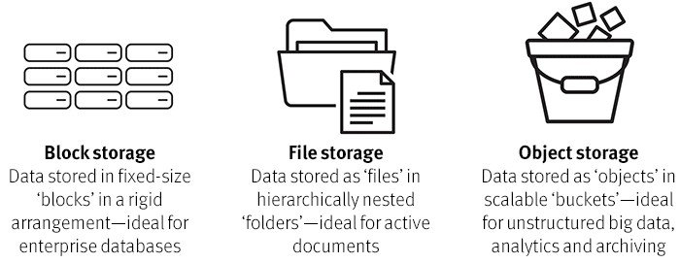
Introduction to Cloud Computing and Amazon web services
File Storage:
The most traditional service type is a shared file system, or simply “file storage” which allows users to access shared folders. The two most popular shared file system protocols in use today are Network File System (NFS) and SMB/CIFS (Server Message Block/Common Internet File System).
56

Slide 57
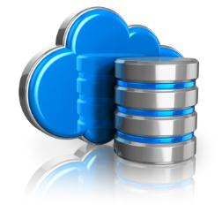

Introduction to Cloud Computing and Amazon web services
Block Storage
Block storage devices provide fixed-size raw storage capacity. Each storage volume can be treated as an independent disk drive and controlled by an external server operating system.
The most common examples of Block Storage are SAN, iSCSI, and local disks.
Block storage devices typically are formatted with a file system like FAT32, NTFS, EXT3, and EXT4.
Object Storage
Data kept on object storage devices consist of the object data and metadata. It can be any kind of data such as photos, videos, and log files.
It can be accessed directly through APIs or http/https.
The object store guarantees that the data will not be lost. Object storage data can be replicated across
different data centers and offer simple web service interfaces for access.
It is ideal to store unstructured data like music, image, and video files.
57

Slide 58
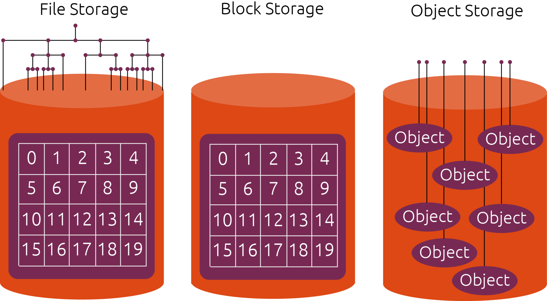
Introduction to Cloud Computing and Amazon web services
IaaS Storage
58

Slide 59


Introduction to Cloud Computing and Amazon web services
IaaS Security issues
With IaaS in public cloud, we control VMs and services running on VMs. The security issues that should
be addressed are:
Data Leakage Protection and Usage Monitoring
Data stored in IaaS infrastructure in both private and public clouds must be closely monitored. Logs should be maintained showing when the data were accessed, by whom and from where. Policies for information need to be created and deployed. In addition, transparent process can be created that monitors information usage.
End-to-End Logging and Reporting
The effective deployment of IaaS demands comprehensive logging and reporting in place. Robust logging and reporting solutions help to keep track of where the information is, who accesses it, which machines are handling it and which storage arrays are responsible for it. These solutions are important for service management and optimization.
59

Slide 60



Introduction to Cloud Computing and Amazon web services
IaaS Security
Authentication and Authorization
Robust authentication and authorization is essential for effective Data Loss Prevention. For every
application, apart login ID and password, a two-factor or multi-factor authentication must be added.
Infrastructure Hardening
Infrastructure hardening is the act of applying security to each component of the infrastructure including: Web servers, application servers, identity and access management solutions, and database systems.
End-to-End Encryption
IaaS should take advantage of end-to-end encryption. The entire disk can be encrypted to prevent offline attacks. Also, all communication to host OS and VMs in the IaaS infrastructure should be encrypted using SSL/TLS.
60

Slide 61


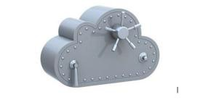
Introduction to Cloud Computing and Amazon web services
Cloud Data Protection
Cloud data protection is a type of data protection model used to protect stored, static and moving data
in the cloud. It is designed to implement optimal data storage, protection and security methodologies.
Cloud data protection provides and ensures various services and processes such as:
Data Integrity: Data are in the same form as its stored version. Data encryption is used to secure
data from illegal editing and corruption.
Storage management: The cloud infrastructure must provide a secure and continuously available interface for data access as required. Logs of each data access, edit and copying event are maintained.
Infrastructure security: These are the collective processes, policies and measures that ensure cloud/storage infrastructure security.
Data Protection as a Service (DPaaS) which provides managed data protection services for stored
cloud data is an example of cloud data protection.
61

Slide 62

Introduction to Cloud Computing and Amazon web services
Cloud Pricing:
In general, Cloud providers use the pay-as-you-go pricing.
However, there are no standards when it comes to pricing across various cloud providers. Therefore,
purchasing decisions are difficult for consumers.
The cloud companies may break down pricing based on whether the virtual machine is dedicated or shared by multiple tenants.
Costs may also be split by compute, storage and networking use on a per GB basis.
62

Slide 63
Introduction to Cloud Computing and Amazon web services
Cloud Pricing:
According to a report from 451 Research Group, some of the ways cloud providers price the services are:
Pricing Model | Description
On-demand pricing | Billed for consumption of virtual machines using a fixed unit price.
Reserved instances | Flat fee in advance with a discounted rate.
Spot pricing | Customers bid to gain access to resources whose price keeps varying.
Prepaid VM access | Customers pay a single fixed fee to access a specifically sized instance for the duration of the plan. It can also be a recurring monthly plan. During this duration they can have unlimited access to the VM.
Recurring resource pooling | Customers commit to purchase a quantity of resources (number of CPU cores, quantity of RAM) in advance, on a recurring basis.
Prepaid Consumption | Customers pay a set amount at the beginning of a term, and costs of consumption are debited from this prepaid amount. It can be done in a recurring plan as well.
63

Slide 64

Introduction to Cloud Computing and Amazon web services
Migrating to the Cloud:
Cloud migration is the process of moving data, applications or other business elements from an organization's onsite computers to the cloud, or moving them from one cloud environment to another.
Moving data or business elements from one cloud environment to another is called “cloud-to-cloud migration”.
The process of transitioning to a different cloud provider is called “cloud service migration”.
A successful migration to a cloud requires the use of middleware such as a cloud integration tool.
33

Slide 65
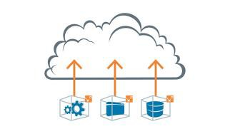

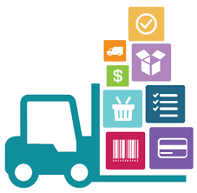
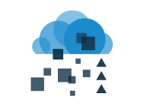
Introduction to Cloud Computing and Amazon web services
Migrating to the Cloud:
There are three common approaches to migrate the on-premise applications to the cloud. They are:
Lift and Shift
the Lift and Shift approach involves the exact replication of the in-house applications in the cloud. There is no change made to the code or the design of applications. It involves much lesser time, cost and complexity when compared with other methods. Storage infrastructure and disaster recovery are common applications migrated using this approach.
Refactoring
Refactoring refers to changes made in the structure of the source code of the application in order to make it more efficient. The code is modified such that it becomes more scalable and reusable without changing the functions of the application.
Modernization
The modernization application approach to cloud computing redesigns the application from
ground-up. Thus, making it completely flexible for the cloud environment.
34

Slide 66

Introduction to Cloud Computing and Amazon web services
IaaS Benefits:
Cost Savings – moving to cloud means lower Infrastructure costs, no maintenance overhead and no need to worry about ensuring uptime. The pay-as-you-go model of cloud offers significant cost savings since organisations pay only for what they use. The IaaS model demands no upfront charges, bandwidth utilization fees or minimum term commitments.
Scalability and Flexibility - the most important benefit of IaaS is the ability to scale up and down depending on the enterprise’s requirements. This on-demand scalability results in flexibility and agility to respond to changing opportunities. This scalability also helps in quickly building and dismantling test and development environments.
Faster Time to Market – time to market is the best way to beat competition. The scalability and flexibility IaaS provider can help in getting the job done faster and get the service or product rapidly to the market.
66

Slide 67
Introduction to Cloud Computing and Amazon web services
IaaS Benefits:
Support for DR, BC and high availability
Every enterprise requires a Disaster Recovery and Business Continuity plan in place. However, the technology behind these is often quite expensive and for organizations with more than one location managing of this infrastructure becomes more difficult.
IaaS provides a consolidated Disaster Recovery infrastructure which ensures quick recovery with no loss of data.
Focus on business growth
Moving to the cloud saves precious time that was being used to deal with maintenance issues and helps the business focus on growth.
67

Slide 68



Introduction to Cloud Computing and Amazon web services
IaaS Risks:
Privacy and Security in the Cloud
One of the biggest concerns a business has while adopting IaaS is the security of confidential enterprise data and information. The credibility of the service provider is of utmost importance, the business must evaluate all possible alternatives before choosing one.
Downtime and Technical Difficulties
Systems face dysfunction and issues from time to time. Besides access to cloud, it is completely dependent on internet access, and any connectivity issues will render the whole system useless.
Increased Vulnerability
Cloud-based solutions have a greater risk of attacks from malicious users and hackers.
Limited Control and Flexibility
IaaS means, business has limited control over the execution of software and hardware that run on
virtual environments.
68

Slide 69

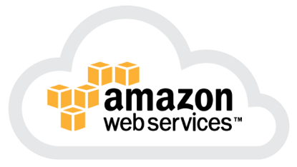
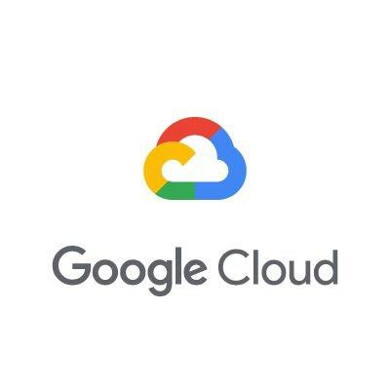
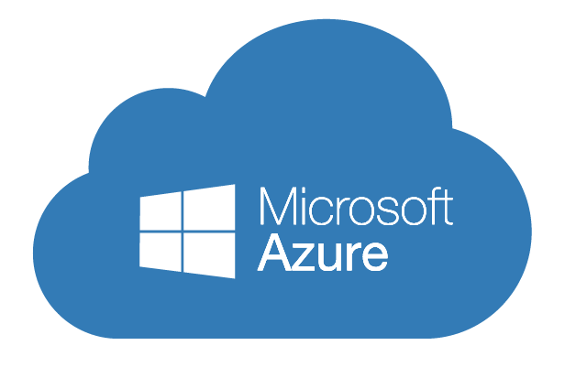


Introduction to Cloud Computing and Amazon web services
Infrastructure as a Service – Some examples are:
Amazon EC2
Windows Azure
Rackspace
Google Compute Engine
IaaS
69

Slide 70
Introduction to Cloud Computing and Amazon web services
Platform as a Service
70

Slide 71
Introduction to Cloud Computing and Amazon web services
PaaS
Overview
IaaS vs PaaS
PaaS Examples
PaaS Benefits and Risks
71

Slide 72
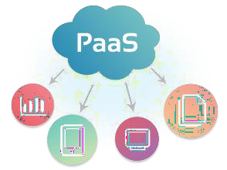
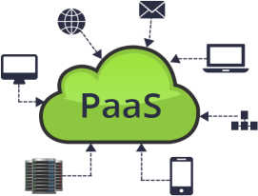
Introduction to Cloud Computing and Amazon web services
PaaS – Platform as a Service
Platform as a service (PaaS) is a complete development and deployment environment in the cloud with resources that enable you to deliver everything from simple cloud-based apps to sophisticated, cloud-enabled enterprise applications.
You purchase the resources you need from a cloud service provider on a pay-as-you-go basis and access them
over a secure Internet connection.
Who can benefit from PaaS?
Software developers can take advantage of a PaaS solution to build an application which they are planning to
offer over the internet.
Web developers can use individual PaaS environments at every stage of the process to develop, test, and host their websites.
Businesses can develop their own internal software, particularly to create distinct ring-fenced development and
testing environments.
72

Slide 73
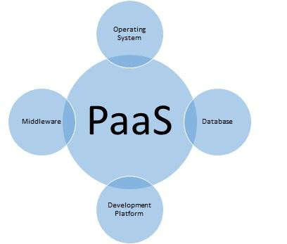
Introduction to Cloud Computing and Amazon web services
PaaS – Platform as a Service
PaaS includes:
Infrastructure such as servers, storage and networking
Middleware (such as IIS, Tomcat, Caching Services)
Development tools
Business Intelligence (BI) services
Database management systems (SQL Server, Oracle,
MySQL)
Runtime (JRE and .NET Framework)
PaaS is designed to support the complete web application
lifecycle:
Building, Testing, Deploying, Managing and Updating.
73

Slide 74
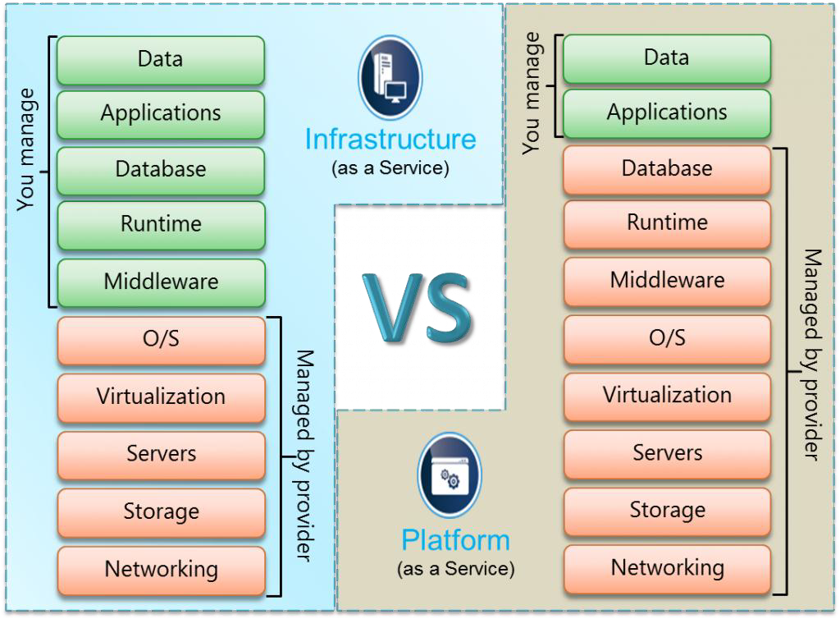
Introduction to Cloud Computing and Amazon web services
IaaS vs. PaaS
74

Slide 75
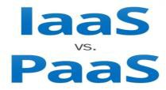
Introduction to Cloud Computing and Amazon web services
IaaS vs. PaaS
IaaS | PaaS
IaaS refers to the cloud service model that provides on- demand infrastructure services to the customer. The infrastructure may refer to rentable resources such as computation power, storage, load-balancer, and so on. | Platform as a service (PaaS) is a complete development and deployment environment in the cloud. It includes infrastructure as well as middleware development tools and database management systems.
The IaaS provider is responsible for managing physical resources such as servers, networking, and storage. Virtualization and operating system are also managed by the provider. | In PaaS model, the application and data are managed by the user, whereas the physical components, middleware, operating system, databases, and runtime are handled by the provider.
Examples include: Amazon EC2 Windows Azure Rackspace Google Compute Engine | Examples include: Windows Azure Force.com NETSUITE AT&T
75

Slide 76




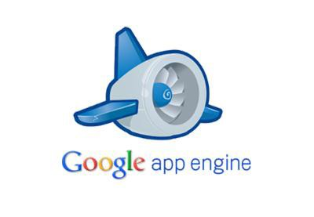
Introduction to Cloud Computing and Amazon web services
Platform as a Service – Some examples are:
NetSuite
Windows Azure
Rackspace
Google App Engine
PaaS
76

Slide 77
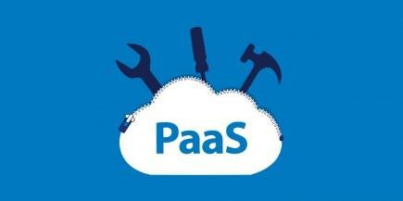
Introduction to Cloud Computing and Amazon web services
PaaS Benefits
Reduced Development Time
The server side components such as web servers, storage, and networking are provided by the PaaS provider. The development team need not configure or maintain them. This saves time and results in faster development.
Support for Different Programming Languages
PaaS services support many different programming languages allowing the developers to develop simple web
applications to enterprise cloud solutions on the same platform.
Easy Collaboration for Remote and Distributed Teams
In today’s world of freelancing and outsourcing, software development team may be distributed over different locations all over the world. PaaS services make it possible for these distributed teams to collaborate and allows them to access the same software platform from anywhere and at any time.
High Development Capabilities without Additional Staff
PaaS providers provide, maintain, and upgrade all hardware and middleware, thus eliminating the need for staff to do all these tasks.
77

Slide 78


Introduction to Cloud Computing and Amazon web services
PaaS Risks:
Although PaaS services have many benefits, they also come with some disadvantages:
You have no control over the virtual machine that processes your data.
PaaS solutions are less flexible than IaaS. For example, you cannot create and delete several virtual machines at a time.
It comes with a predefined programming model which can result in vendor lock-in issues since you have to use
only the languages offered.
Migration to the cloud can be difficult if the existing code is not supported by the provider.
78

Slide 79
Introduction to Cloud Computing and Amazon web services
Software as a Service
79

Slide 80
Introduction to Cloud Computing and Amazon web services
SaaS
Overview
SaaS Examples
Office 365
Google G Suite
Salesforce.com
Evaluating SaaS
Impact of SaaS
Benefits and Risks
80

Slide 81
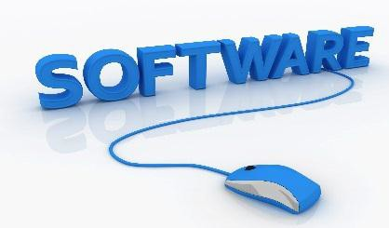
Introduction to Cloud Computing and Amazon web services
Software as a Service – SaaS
Software as a service (SaaS) allows users to connect to and use cloud-based apps over the Internet. Common examples are email, calendaring, and office tools such as Microsoft Office 365.
SaaS provides a complete software solution which you purchase on a pay-as-you-go basis from a cloud service
provider.
You rent the use of an app for your organization and your users connect to it over the Internet, usually with a web browser. All of the underlying infrastructure, middleware, app software, and app data are located in the service provider’s data center.
The service provider manages the hardware and software, and with the appropriate service agreement, it will ensure the availability and the security of the app and your data as well. SaaS allows your organization to get quickly up-and-running with an app at minimal upfront cost.
81

Slide 82

Introduction to Cloud Computing and Amazon web services
Traditional Software vs SaaS
SaaS products are generally prebuilt and consumed using the provided functionality without significant customization, as in the case of Google Gmail users who simply access the web-based standard email and calendaring application.
Traditional software requires a capital expense to purchase and operating expenses to install, update, and maintain. Traditional software application management follows a predictable process:
Identify software meeting requirements.
Perform capital acquisition for identified software.
Install software to client computers.
Patch software in maintenance cycle.
Perform acquisition for software update.
Install software update to client computers.
Return to maintenance cycle until next software update.
82

Slide 83

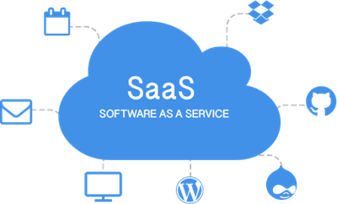
Introduction to Cloud Computing and Amazon web services
By contrast, SaaS application management requires far fewer steps for the consuming organization:
Identify cloud service providers whose software meets organizational requirements.
Obtain licensing for identified software service access.
After this, all maintenance, including patches and updates, are handled by the cloud SaaS provider.
83

Slide 84
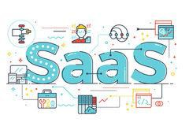
Introduction to Cloud Computing and Amazon web services
SaaS Benefits
Business agility is enhanced by ensuring that mobile workers have access to key business applications from anywhere, anytime.
Displaced employees retain operational capability during widespread natural disasters, and organizational
data resources can simply be moved to cloud provider storage outside of the affected area in case of a disaster.
Organizations can take advantage of resource sharing between employees working in different time zones or
across different geopolitical zones.
Organizations can implement sustainable “green” initiatives such as remote travel-free employees, who do not require leased space, dedicated equipment, and costly environmental control in expensive central office facilities.
84

Slide 85


Introduction to Cloud Computing and Amazon web services
SaaS Risks
Usage Risk
The risk an organization incurs when using the app, such as using it for some critical function or for storing sensitive information will be considered high risk. Whereas, an app for scheduling get-together for employees with pets, will be considered low risk.
Data Security Risk
While Usage Risk focuses on how your organization is using the app, Data Security Risk focuses on how the service provider is handling your data. It is crucial to know whether it is encrypted in transit or at rest and whether the app controls are in place to determine how the data is stored and who can view it.
85

Slide 86


Introduction to Cloud Computing and Amazon web services
SaaS Risks
SaaS Provider Operational Risk
This includes issues such as the uptime SLA guaranteed by the provider, whether there is 24×7 support, the
compliance certificates obtained by the provider and the Disaster Recovery strategy of the provider.
SaaS Provider Application Risk
Application risk is the inherent risk of an app such as, how does the app handle authentication and authorization, the development practices used by the provider to address configuration vulnerabilities and session management vulnerabilities.
86

Slide 87

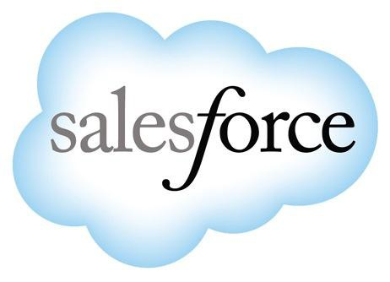
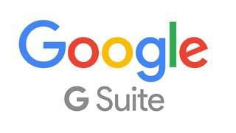
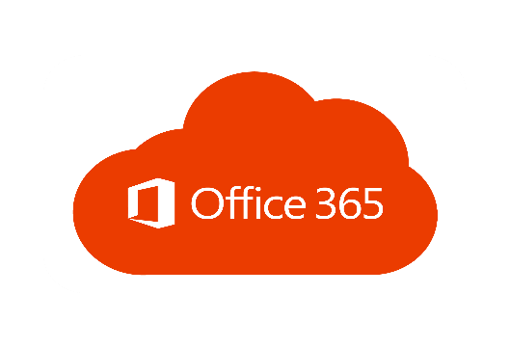

Introduction to Cloud Computing and Amazon web services
Platform as a Service – Some examples are:
Salesforce.com
Office 365
Zoho
Google G Suite
SaaS
87

Slide 88
Introduction to Cloud Computing and Amazon web services
Office 365
Microsoft Office 365 is the cloud application suite developed by Microsoft, and is considered one of the best cloud-based services for small, medium, and large businesses.
It works on the SaaS model, all the software is installed and maintained on the cloud.
Office 365 is a cloud-based service that provides the best business emailing solutions and productivity tools like Mailbox, Skype, One Drive, Online Docs, Online Word, Yammer, Online Excel, and Calendar which helps you and your team to work from anywhere, anytime, and on any device. In short, it is the Office, whenever and wherever you need it.
Office 365 helps business to increase employee productivity by saving time, money, and resources.
There are different Office 365 plans to which users can subscribe.
88

Slide 89
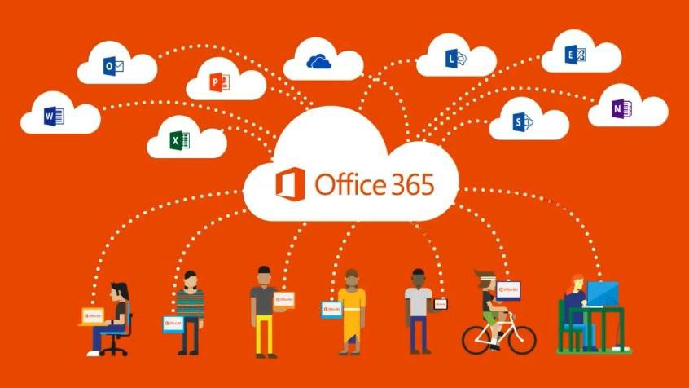
Introduction to Cloud Computing and Amazon web services
Office 365
89

Slide 90

Introduction to Cloud Computing and Amazon web services
Office 365 Services
Office 365 offers:
Office online is similar to MS office, except that the office online apps can be accessed only through internet, making it easier for users in different locations to collaborate and share data.
Exchange online is an application for IT managers. It gives centralized control of all mailboxes of the company to set the mail policy, security, and filter spams. It also offers data loss prevention capabilities.
SharePoint online is a web application to modernise the on-premise infrastructure. It allows to create
team sites or portals to share to discover and collaborate on content from inside or outside the organization.
Yammer is an enterprise-based social networking service that helps an organization connect and interact
privately.
90

Slide 91
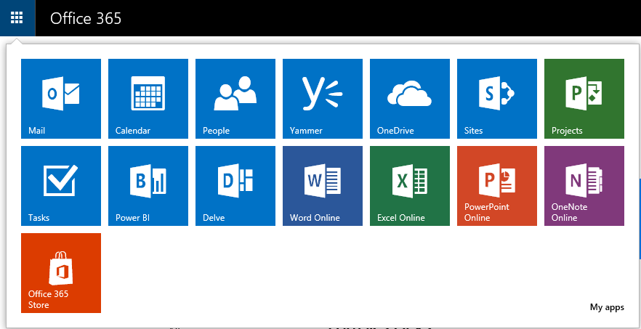
Introduction to Cloud Computing and Amazon web services
Office 365 apps
91

Slide 92


Introduction to Cloud Computing and Amazon web services
Office Online Apps
Office online apps include:
Mail box: You can stay connected to your emails and it also has OWA (Outlook Web Access) which is
similar to Outlook.
Skype for Business: Skype for Business which combines instant messaging, voice, online meetings and video conferencing, provides users with the rich and consistent experience of a consolidated system.
Word Online: Create, edit, collaborate, and share your word documents or files from anywhere.
Excel Online: Analyze and organize your data in Excel spreadsheets & workbooks.
PowerPoint Online: Create powerful presentations and share with your team from anywhere, anytime.
OneNote Online: Helps you in gathering information and multi-user collaboration. Users can make handwritten or typed notes, drawings, screenshots, videos, and audios.
Calendar: Helps you to Invite, set reminders and track RSVP to manage your schedule.
OneDrive: Save your photos, videos, documents, spreadsheets, etc., and access them from anywhere.
Docs: Share your documents (Word, Excel, PowerPoint, OneNote, Sway, and PDF). You can upload the documents from Computer or OneDrive.
92

Slide 93
Introduction to Cloud Computing and Amazon web services
Office 365 Features and Benefits
Easily Accessible: Office 365 applications and services can be accessed from anywhere in the world provided you have internet access.
Automatic Updates: Ready-to-use software are provided by the cloud itself to its users with automatic
updates.
Prevents Data Loss: Your Data is safe as it is backed up on the cloud.
Great Security: Every Office 365 user gets a unique username and password to authenticate their user account and proactive monitoring helps keep customer data safe.
Reduces IT Expenses: It reduces your IT Infrastructure cost as well, as the cost of updating the software.
Pay as you want – You pay to subscribe the tools and services as per your requirements.
93

Slide 94

Introduction to Cloud Computing and Amazon web services
Google G Suite
Google G Suite is the new Google App for businesses.
Google G Suite is the cloud-based alternative to suites like Microsoft Office.
It comes with some free apps such as Gmail but the suite itself needs subscription – monthly or annually
billed.
The basic plan of G Suite gives 30GB storage, which is double the space available with free plan. The business plan offers unlimited storage (in case of more than five employees) along with a better admin control panel and the Vault for archiving emails.
94

Slide 95
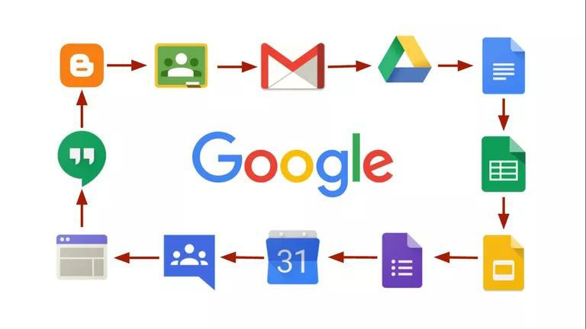
Introduction to Cloud Computing and Amazon web services
Google G Suite
95

Slide 96
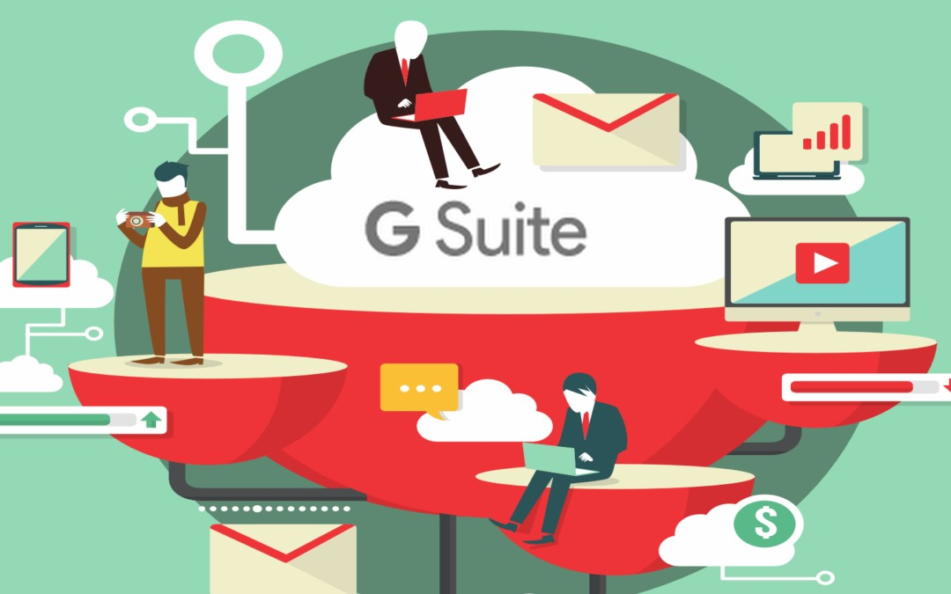
Introduction to Cloud Computing and Amazon web services
Google G Suite
Google G Suite offers:
Business email addresses (name@company.com)
Video and voice calls
Online calendars
Online text documents, spreadsheets, and slides
Project sites (a way to build simple websites or intranet)
Security and admin controls
24/7 phone and email support.
On the Unlimited plan, in addition to the above you get
Advanced admin controls for Drive
Audit and reporting insights for Drive content and sharing
Google Vault for eDiscovery covering emails, chats, docs, and files
Advanced search
More options when it comes to file exports
Email archives
Set message-retention policies
Litigation holds on inboxes
96

Slide 97


Introduction to Cloud Computing and Amazon web services
Salesforce.com
Salesforce.com is a cloud computing and social enterprise software as a service (SaaS) provider based in San Francisco. It was founded in March 1999, in part by former Oracle executive Marc Benioff.
Salesforce.com is best known for its Salesforce Customer Relationship Management (CRM) product which is composed of Sales Cloud, Service Cloud, Marketing Cloud, Commerce Cloud, Analytics Cloud, IoT Cloud, App Cloud, Health Cloud, Financial Services Cloud, Force.com, and Chatter.
What is Customer Relationship Management (CRM)?
Customer relationship management (CRM) manages the business' single most important goal – satisfying the customers. Customers are king in any business, CRM helps manage the interactions that are made with customers from the date they start business with the company.

Slide 98

Introduction to Cloud Computing and Amazon web services
Salesforce.com Services

Slide 99



Introduction to Cloud Computing and Amazon web services
Salesforce.com Services
Cloud Services helps track customer information and interactions. It supports sales, marketing, and customer support in both B2B and B2C contexts.
Marketing Cloud helps personalise email marketing, engage mobile messaging, generally manage ad
campaigns for customer acquisition and create a one-to-one customer journeys across channels.
Service Cloud is a service platform for customer service and support. It includes a call center-like case- tracking feature and a social networking plug-in for conversation and analytics. It enables faster resolving of customer problems.
Community Cloud helps build communities which include customers, employees, and partners for developing deeper customer relationships. It allows customers to interact with each other, increase sales by connecting partners, and boost employee productivity through online collaboration.

Slide 100




Introduction to Cloud Computing and Amazon web services
Salesforce.com Services
Commerce Cloud allows businesses to manage digital commerce with integrated solutions for commerce, point of sale, and order management.
Analytics Cloud is a business intelligence platform that allows organizations to instantly get important
answers and start making data-driven decisions.
Salesforce App Cloud is a collection of development tools that allows developers to quickly create
applications that will run on the Salesforce platform.
Salesforce IoT Cloud is a platform in Salesforce.com that harnesses the power of internet of things (IoT) and turns data generated by customers, devices, partners, and sensors into meaningful action. It allows users to process massive quantities of data, build rules with intuitive tools, and engage with customers in real time.

Slide 101



Introduction to Cloud Computing and Amazon web services
Salesforce.com Services
9. Salesforce Financial Services Cloud helps deliver experiences that drive client loyalty through personalized tools, allows more visibility into existing household opportunities and the ability to track referrals, allows instant access to all client data in one central location, and addresses regulatory compliance.
Salesforce Health Cloud is a health IT CRM system that incorporates record management services with the doctor–patient relationship. Health cloud creates an individual profile from each member including demographics, communications and any other pertinent information, all in one location. It allows patients to track progress toward health goals and care plans.
Chatter is an enterprise social network within the Salesforce platform. It helps drive productivity by
connecting employees wherever they are.

Slide 102




Introduction to Cloud Computing and Amazon web services
Salesforce.com
Sales Force provides Sales as a Service (SaaS) that excels at sales tracking, measuring, and organising the
business and is cost effective.
Web CRM Pays For Itself More Quickly. Removing the need for a huge capital investment on IT infrastructure and technical maintenance staff and streamlining existing IT costs with PaaS. It offers a faster return on investment.
Web-based CRM Will Transform Business Faster. Hosted CRM implementations take weeks or months
instead of the 12-month average of client/server CRM tools.
Hosted CRM is more User Friendly. Salesforce's simple-to-use interface appeals even to non-technical users.
On-Demand CRM Provides Unlimited Scalability. Salesforce software uses a multi-tenant approach – there
is no single instance of the software, so it is faster and cheaper to implement.
Web CRM Features Painless Upgrades. Deployments of new features on the customer management systems
are instantaneous, resulting in access to the latest version always.
102

Slide 103

Introduction to Cloud Computing and Amazon web services
Evaluating SaaS

Slide 104



Introduction to Cloud Computing and Amazon web services
Evaluating SaaS – User Perspective
Unlike your relationship with a software vendor who provides you with on-premises software and then exits till the customer needs something, the customer has a close relationship with a SaaS provider, beginning with the subscription purchase. When entrusting the SaaS provider with sensitive business data stored at the
provider’s site, a business becomes dependent on the provider on an ongoing basis for smooth running of systems, innovation, support, and sometimes training. Treading carefully during the selection process can reduce risks to a great extent.
When evaluating SaaS applications the following criteria should be considered:
Strength of SaaS provider’s security processes and standards:
The application and data resides at the vendor’s side; therefore, security is utmost important. The security standards practiced by the vendor should be checked to see if they are compliant with the organization’s security model.
Work with the vendor on a SLA for security that satisfies the organization’s needs. Include penalties
for lack of service on agreed terms in SLA.
Also, processes for disaster recovery, backup, and restore must be included.

Slide 105
Introduction to Cloud Computing and Amazon web services
Evaluating SaaS – User Perspective
Provider’s ability to provide the flexibility needed to meet your needs:
Flexibility includes ease of adding and dropping features from your subscription plan like add seats and whether it can be done online.
Being able to drop the subscription with cause without penalty such as in case of SaaS vendor fails to provide the agreed level of service.
Being able to customize the SaaS application to suit the organisation’s needs.
How difficult is it to get your data back in case if you decide to cancel the subscription?
History of the provider’s regard for its SLAs:
Since we are at the mercy of the SaaS provider for the services to be delivered, it is important to ensure
the reliability of the provider by looking at the previous SLA performance records.
Provider’s business viability and future outlook:
Select a SaaS provider that is going to be in business for a long time. In selecting a SaaS provider, you are looking for a business partner who will not go out of business in a year. You should look at a provider’s experience in providing SaaS solutions, examine financial information, and predicted growth of the business.
105

Slide 106


Introduction to Cloud Computing and Amazon web services
Evaluating SaaS – Vendor Perspective
From a vendor’s perspective, adopting the SaaS model for business, needs the following considerations:
Financial concern: Unlike the traditional model which relied on upfront licensing fee for the software you provide, the cloud model of business relies on the periodic subscription fee. The key to survival is to keep the cash flow by retaining customers. This is a challenge since the switching fee for customers is significantly low.
Compliance issues: Vendors should make sure that national and global compliance requirements are taken care of and regulations are met.
Operational efficiency: 24/7 operability, highly effective business continuity plans, and high-caliber data management and security protocols.
Configuration and Customization: Profitability for the SaaS vendors comes from economies of scale that
SaaS deployment offers like multitenancy. There should be policies in place for the amount of tailoring of
the software to clients’ needs that is allowed.
106

Slide 107

Introduction to Cloud Computing and Amazon web services
Impact of SaaS
As businesses continue to modernise and digitise their offerings, more companies are turning toward cloud systems to handle their software and data needs. By following the SaaS model, companies are seeing faster innovations enabled by deeper analytics, while reducing the amount of space that is required by traditional data centers.
SaaS platforms are based upon user experience and functionality. With the ability to incorporate real-time analytics, businesses can uniquely customise the site experience for each user. Modern SaaS platforms also allow for efficient scalability.
The adoption of SaaS and cloud-based software is a cross-industry phenomenon. Health tech, fintech, retail tech offerings are emerging alongside enterprise applications as a service (e.g., ERP, CRM, HR, accounting).

Slide 108

Introduction to Cloud Computing and Amazon web services
Other Cloud services:
Data as a service (DaaS): Data is stored on cloud and made available to users on demand regardless of their geographic location.
Desktop as a service provides for a virtual desktop.
Storage as a service (SaaS) provides data storage infrastructure.
Test environment as a service: We can rent a test setup to quickly test our application.
Security as a service (SECaaS): We can allow the cloud provider to take care of the security.
API as a service is a SaaS exposed as an API (Application Programming Interface). It allows users to access web services such as Google Maps, credit card processing and payroll processing.

Slide 109

Introduction to Cloud Computing and Amazon web services
Cloud Delivery Models Considerations
Due to economies of scale, cloud providers have the potential to offer state-of-the-art cloud ecosystems that are
resilient and secure—far more secure than the environments of consumers who manage their own systems.
This has the potential to greatly benefit many organizations.
Cloud-based information systems are exposed to threats that can have adverse effects on organizational operations (i.e., missions, functions, image, or reputation), organizational assets, individuals, and other organizations.
Malicious entities can exploit both known and unknown vulnerabilities to compromise the confidentiality,
integrity, or availability of the information being processed, stored, or transmitted by those systems.
There are many types of risk that organizations need to address: program management, investment, budget, legal liability, safety, inventory, supply chain, security, and more.

Slide 110
Introduction to Cloud Computing and Amazon web services
Cloud Computing Models

Slide 111

Introduction to Cloud Computing and Amazon web services
Cloud Deployment Models:
National Institution of Standards and Technology (NIST) operate under the US Department of Commerce
and has defined many of the key concepts used in cloud computing.
NIST Special Publication 800-145 identifies four models for cloud deployments. These are:
Public Cloud
Private Cloud
Community Cloud
Hybrid Cloud

Slide 112

Introduction to Cloud Computing and Amazon web services
Cloud Deployment Models:
Private cloud – owned by a single organization
Public cloud – accessible to the
public
Community cloud – shared by a
group of organizations
Hybrid cloud – a combination of the above three clouds

Slide 113

Introduction to Cloud Computing and Amazon web services
Public Cloud
Public clouds are external, publicly available environments accessible to multiple tenants.
The cloud provider is responsible for the creation and the on-going maintenance of the public cloud and its IT resources.
Public clouds are ideal for individuals, startups and other organizations with financial restrictions.

Slide 114

Introduction to Cloud Computing and Amazon web services
Public Cloud
Some of the Public cloud examples include Amazon Web Services, Microsoft Azure, IBM Cloud and Google Cloud Platform.

Slide 115

Introduction to Cloud Computing and Amazon web services
The Case of Public Cloud
Consider this,
Connected Solutions is a startup venture started by four classmates who are interested in developing IoT (Internet of Things) solutions. However, when it comes to investing in infrastructure like storage and networking, finance is an issue. What would Connected Solutions do?
If you are limited in financial resources but still require a good amount of space to store your
data, using a public cloud is the best option.
There are good public cloud pricing plans that offer good amount of storage.
Additionally, public clouds tend to use the latest technological advancements (hardware, software and so on), have better utilization rates, provide greater elasticity and continually test your applications and networks.

Slide 116

Introduction to Cloud Computing and Amazon web services
Private Cloud
A Private Cloud is owned by a single organization.
Private cloud helps an organization in centralizing the access of IT resources by its various locations and departments.
Private clouds are ideal, especially for organizations that have heavily invested in infrastructure.

Slide 117

Introduction to Cloud Computing and Amazon web services
The Case of Private Cloud
Consider this as an example,
You are a financial organization with a big infrastructure. You deal with sensitive information, hence, security is of utmost importance. You want your infrastructure to be centralized, secure and to have a greater control over it. What is your best option?
A private cloud though expensive, comes with greater security and control.
A private cloud is custom designed by you for your business.
It allows for rapid scaling of business operations.
And most importantly, when issues arise, you can prioritize and handle them, unlike a public cloud where the delays in resolving an issue may pile up.

Slide 118

Introduction to Cloud Computing and Amazon web services
Public Cloud vs Private Cloud
Private clouds combine the security of keeping resources in-house with the scalability of the cloud by storing resources privately. Therefore, they are an ideal solution for companies with compliance requirements who cannot host their resources on a public cloud.
However, public clouds are best when facing financial restrictions and are not dealing with sensitive information.

Slide 119

Introduction to Cloud Computing and Amazon web services
Public Cloud vs Private Cloud

Slide 120

Introduction to Cloud Computing and Amazon web services
Community Cloud
Community cloud model is shared by a group of organizations with similar requirements such as security, compliance and IT policies.
The community cloud may be jointly owned by the community members or by a third-party cloud provider that provisions a public cloud with limited access.

Slide 121

Introduction to Cloud Computing and Amazon web services
The Case of Community Cloud
For example, the Department of Defense and some intelligence agencies have launched data center improvement initiatives using a community cloud. This enables them to easily share data with other agencies in the community cloud, while still keeping it secure and controlled.
Another industry taking advantage of community clouds is the healthcare industry, where everyone in the community can support patients and exchange data in a controlled way.
Uses of community cloud:
Allows for easy sharing and collaboration
Lowers costs

Slide 122

Introduction to Cloud Computing and Amazon web services
Hybrid Cloud
Hybrid cloud is a combination of two or more models, private cloud, public cloud or community cloud.
For example, a cloud consumer may choose to deploy cloud services, processing sensitive data to a private cloud, and other less sensitive cloud services to a public cloud. The result of this combination is a hybrid deployment model.

Slide 123

Introduction to Cloud Computing and Amazon web services
The Case of Hybrid Cloud
Consider a business with dynamic work load that experiences significant hike in business during holiday season. They require more resources to handle the peak season. However, these resources are not required for the rest of the year. What would be the best option?
A hybrid cloud - A private cloud for off season operations and public cloud services for the holiday season is an ideal combination for such a business.

Slide 124

Introduction to Cloud Computing and Amazon web services
Other Deployment Models:
There are other variations of the basic cloud deployment models such as:
Virtual Private Cloud: also called ‘dedicated cloud’ or ‘hosted cloud’ is a self- contained cloud environment hosted and managed by a public cloud provider.

Slide 125

Introduction to Cloud Computing and Amazon web services
Other Deployment Models:
Inter-Cloud: comprised of two or more interconnected clouds.

Slide 126

Introduction to Cloud Computing and Amazon web services
Advantages of Cloud Computing Models:

Slide 127
Introduction to Cloud Computing and Amazon web services
Advantages of Cloud Computing
Cost Efficient – the pay-as-you-go model significantly minimizes the organization’s costs.
Almost Unlimited Storage – Using cloud storage means unlimited storage capability. No running out of storage or no need of investing in storage devices.
Backup and Recovery – all the data are backed up on to the cloud. Hence, backup and
recovery becomes more easier.
Automatic Software Integration – the changes to the software made by different developers are tested and integrated several times in a day. This is automatically done when using cloud.
Easy Access to Information – once registered, information can be accessed from any location and from any device.
Quick Deployment – using cloud you can get your entire system fully functioning in
just a couple of minutes.
127

Slide 128
Introduction to Cloud Computing and Amazon web services
Disadvantages of Cloud Computing:
Technical issues:
Though cloud enables you to access information from anywhere and on any device, the system can sometimes malfunction and besides that you also need a strong internet connection.
Security in Cloud:
You should always be careful to choose the most reliable service provider since the company’s sensitive information is being handed over to a third party for storage.
Prone to Attack:
Storing information in the cloud makes it accessible to hackers.

Slide 129
Introduction to Cloud Computing and Amazon web services
Cloud Computing Case Studies

Slide 130

Case Study I
Introduction to Cloud Computing and Amazon web services
WhatsApp (hosted on IBM Softlayer)
WhatsApp started as an inexpensive messaging service to link people over internet. However, in a short period of time it became a huge success and a messaging giant.

Slide 131

Introduction to Cloud Computing and Amazon web services
Case Study I
Case Scenario:
At the beginning, WhatsApp had 50 million users. This number grew to 200 million by third year of its operation and doubled in the next year and reached more than 400 million users. The ever growing numbers of users was a real challenge for WhatsApp. The messaging giant made top news in 2014 when Facebook announced it would acquire WhatsApp for a whopping $19 billion.
Solution:
The Company turned to IBM Softlayer to find unique platform as a service capabilities which could connect its app and data to the cloud and manage exponential growth in its users.

Slide 132

Introduction to Cloud Computing and Amazon web services
Case Study I
WhatsApp (hosted on IBM Softlayer) Benefits:
Exchange of data can be done on the cloud.
Developers do not need to spend time on database management.
With this platform, they can extend the app’s capabilities and include a wide variety of both structured and unstructured data.
The application can be accessed 24/7 and can be scaled to massive volumes of networks, users and devices.

Slide 133

Introduction to Cloud Computing and Amazon web services
Case Study II
ICICI Lombard (hosted on Microsoft Azure)
ICICI Lombard lays its expansion plans by leveraging the power of public cloud with no compromise on security.

Slide 134

Introduction to Cloud Computing and Amazon web services
Case Study II
ICICI Lombard (hosted on Microsoft Azure) Case Scenario:
As ICICI Lombard was moving towards a more customer centric approach with cutting edge technology, there was one unsolved mystery to be tackled, ‘How to handle applications with peak times that are exponentially higher than the average?’ Provisioning and de-provisioning of servers based on these varying peak loads caused time, cost and resource pressures on the organization.
Solution:
ICICI Lombard turned to Microsoft Azure to manage the IT infrastructure for applications like email systems and storage. The constant technical support and the matured security measures offered by Azure, enabled the client to move more complex applications to the cloud.

Slide 135
Introduction to Cloud Computing and Amazon web services
Case Study II
ICICI Lombard (hosted on Microsoft Azure) Benefits:
ICICI Lombard now enjoys automated management of the platform and applications, thus reducing the cost and time considerably.
More than 30 UAT servers have been decommissioned after a batch of 17 applications were moved to the cloud.
With more non-production applications being hosted on the Azure cloud, the time-to-market has been enhanced, and more maturity is observed in SDLC.

Slide 136

Introduction to Cloud Computing and Amazon web services
Case Study III
Expedia (hosted on Amazon)
Expedia partners with Amazon Web Services (AWS) to enhance online customer experience.

Slide 137

Introduction to Cloud Computing and Amazon web services
Case Study III
Expedia (hosted on Amazon) Case Scenario:
Expedia is the largest online travel brand that includes several travel and hospitality platforms such as Expedia.com, Hotwire.com, Hotels.com and so on. It acts as the ultimate bridge between consumers and the travel industry in several countries. In 2010, Expedia launched the Expedia Suggest Service (ESS) that assists travellers to enter their travel information accurately. Delivering the maximum level of responsiveness with minimal network latency were the biggest challenges of ESS.
Solution:
The cloud expertise offered by AWS enabled Expedia to build ESS in only 3 months. The service was launched initially in Singapore and after tasting success it was quickly replicated across regions in the United States and Europe. The average network latency was reduced from almost 700 ms to just 50 ms by hosting the high-volume, critical ESS on AWS cloud.

Slide 138
Introduction to Cloud Computing and Amazon web services
Case Study III
Expedia (hosted on Amazon) Benefits:
Enhanced online customer experience through reduced errors and increased speed.
Reduced costs by eliminating the need to run the service full-fledged across locations closer to the customers.
Increased availability of the service with easier troubleshooting of issues.

Slide 139
Introduction to Cloud Computing and Amazon web services
Cloud Security

Slide 140

Introduction to Cloud Computing and Amazon web services
Cloud Security
Cloud security has to be a part of your company’s overall security strategy. Most companies place a high priority on the testing and monitoring of threats to their data center, buildings, people, and information.
Security concerns associated with cloud computing fall into two broad categories:
Security issues faced by cloud providers (organizations providing software, platform, or
infrastructure as a service via the cloud).
Security issues faced by their customers (companies or organizations who host applications or store data on the cloud).
However, the responsibility is shared. The provider must ensure that their infrastructure is secure and that their clients’ data and applications are protected, while the user must take measures to secure their applications by using strong passwords and authentication measures.

Slide 141
Introduction to Cloud Computing and Amazon web services
Cloud Security
Security issues faced by cloud providers:
When an organization opts to store data or host applications on the public cloud, it loses the ability to have physical access to the servers. The data are at potential risk from insider attacks. Therefore, cloud providers must ensure thorough background checks of all employees who have physical access to the servers.
To conserve resources and cut costs, cloud providers often store more than one customer’s data on the same server. This may result in a situation where one customer’s data becomes visible to the other. Cloud providers should ensure data isolation and logical storage segregation to handle such sensitive issues.
Cloud uses virtualization extensively which can give rise to more security concerns. Virtualization is an additional layer that should be properly configured, managed, and secured. For example, a breach in the administrator workstation with the management software of the virtualization software can cause the whole data center to go down or be reconfigured to an attacker's liking.

Slide 142

Introduction to Cloud Computing and Amazon web services
Cloud Security
Even when cloud operators have good security (physical, network, OS, and application infrastructure), it
is the company’s responsibility to protect and secure applications and information.
Reducing Cloud Security Breaches:
Authenticate all people accessing the network.
Frame all access permissions so that users have access only to the applications, and data that they have been granted specific permission to access.
Authenticate all software running on any computer—and all changes to such software.
This includes software or services running in the cloud. Your cloud provider needs to automate and authenticate software patches and configuration changes, as well as manage security patches in a proactive way. Why is this so important to understand? Many cloud service provider outages typically come from configuration mistakes. If a cloud provider does not update security, your intellectual property could be at risk.

Slide 143

Introduction to Cloud Computing and Amazon web services
Cloud Security
Formalize the process of requesting permission to access the data or applications. This applies to your own internal systems and the services that are required to put your data into the cloud.
Monitor all network activity and log all unusual activity. In most cases, you should deploy intruder-detection technology. Although your cloud services provider may enable you to monitor activities on its environment, you should have an independent view. This is especially important for compliance.
Log all user activity and program activity and analyze it for unexpected behaviour.
Encrypt, up to the point of use, all valuable data that needs extra protection.
Regularly check the network for vulnerabilities in all software exposed to the internet or any external users.

Slide 144
Introduction to Cloud Computing and Amazon web services
Amazon Web Services

Slide 145
Introduction to Cloud Computing and Amazon web services
Amazon Web Services
Compute
Storage
Databases and Data management
Migration and Hybrid cloud
Networking
Development tools and application services
Management and Monitoring
Security and Governance
Big data management and Analytics
Artificial intelligence
Mobile development
Messages and Notifications
Other services
AWS pricing models
145

Slide 146



Introduction to Cloud Computing and Amazon web services
Amazon Web Services (AWS)
Amazon Web Services (AWS) is a comprehensive, evolving cloud computing platform provided by Amazon. It provides a mix of infrastructure as a service (IaaS), platform as a service (PaaS), and packaged software as a service (SaaS) offerings.
AWS was launched in 2006 from the internal infrastructure that Amazon.com built to handle its online
retail operations.
AWS was one of the first companies to introduce a pay-as-you-go cloud computing model that scales to provide users with compute, storage or throughput as needed.
Amazon Web Services provides services from dozens of data centers spread across availability zones (AZs) in regions across the world. An AZ represents a location that typically contains multiple physical data centers, while a region is a collection of AZs in geographic proximity connected by low-latency network links.
13

Slide 147

Introduction to Cloud Computing and Amazon web services
Amazon Web Services (AWS)
The building blocks of EC2, EBS, S3, etc. provide IaaS functionality, in fact AWS is the leader in this category.
From there on, rather than adopting a discrete binary approach of IaaS vs PaaS, AWS has done a great job of viewing it as a continuum and has introduced several services in the middle:
DBaaS – Database as a Service
FSaaS – File System as a Service

Slide 148

Introduction to Cloud Computing and Amazon web services
Amazon Web Services (AWS)

Slide 149


Introduction to Cloud Computing and Amazon web services
AWS Services
Amazon Web Services is comprised of more than 100 services grouped into categories:
AWS Compute:
Amazon Elastic Compute Cloud (EC2) provides virtual servers, called instances, for compute capacity.
The EC2 service offers dozens of instance types with varying capacities and sizes, tailored to specific
workload types and applications, such as memory-intensive and accelerated-computing jobs.
AWS also provides an Auto Scaling tool to dynamically scale capacity to maintain instance health and performance.
A developer can also use AWS Lambda for server-less functions that automatically run code for applications and services.
AWS Elastic Beanstalk can be used for PaaS.
AWS also includes Amazon Lightsail which provides virtual private servers, and AWS Batch which processes a series of jobs.

Slide 150


Introduction to Cloud Computing and Amazon web services
AWS Services
Storage:
When it comes to storage, Amazon provides:
S3 Storage for storing objects.
Organizations can opt for S3 infrequent storage to save costs.
Glacier for long term cold storage of data.
Amazon Elastic File System offers managed cloud-based file storage.
Amazon Elastic Block Storage for block-level storage.
A business can also migrate data to the cloud via physical storage transport devices, such as AWS Snowball
and Snowmobile, or use AWS Storage Gateway to enable on-premises apps to access cloud data.

Slide 151

Introduction to Cloud Computing and Amazon web services
AWS Services – Snow Family

Slide 152

Introduction to Cloud Computing and Amazon web services
AWS Services - Snowball

Slide 153



Introduction to Cloud Computing and Amazon web services
AWS Services:
Databases and data management:
AWS provides managed database services through its Amazon Relational Database Service, which includes options for Oracle, SQL Server, PostgreSQL, MySQL, MariaDB and a proprietary high- performance database called Amazon Aurora. AWS offers managed NoSQL databases through Amazon DynamoDB.
Migration, hybrid cloud:
AWS includes various tools and services designed to help users migrate applications, databases, servers, and data onto its public cloud. The AWS Migration Hub provides a location to monitor and manage migrations from on premises to the cloud. Once in the cloud, EC2 Systems Manager helps an IT team configure on-premises servers and AWS instances.

Slide 154


Introduction to Cloud Computing and Amazon web services
AWS Services:
5. Networking:
An Amazon Virtual Private Cloud (VPC) gives an administrator control over a virtual network to use an isolated section of the AWS cloud. AWS automatically provisions new resources within a VPC for extra protection.
Admins can balance network traffic with AWS load balancing tools, including Application Load Balancer and Network Load Balancer.
AWS also provides a domain name system called Amazon Route 53 that routes end users to
applications.
Users can establish a dedicated connection from an on-premises data center to the AWS cloud via AWS Direct Connect.

Slide 155

Introduction to Cloud Computing and Amazon web services
AWS Services – Virtual Private Network

Slide 156

Introduction to Cloud Computing and Amazon web services
AWS Services – Route53

Slide 157

Introduction to Cloud Computing and Amazon web services
AWS Services
6. Development tools and application services:
AWS command-line tools and software development kits (SDKs) can be used to deploy and manage applications and services. The AWS Command Line Interface is Amazon's proprietary code interface.
A developer can also use AWS Tools for Powershell to manage cloud services from Windows environments and AWS Serverless Application Model to simulate an AWS environment to test Lambda functions.
AWS SDKs are available for a variety of platforms and programming languages, including Java, PHP, Python, Node.js, Ruby, C++, Android, and iOS.
Amazon API Gateway enables a development team to create, manage, and monitor custom APIs that let applications access data or functionality from back-end services. API Gateway manages thousands of concurrent API calls at once.
A development team can also create continuous integration and continuous delivery pipelines with
services like AWS CodePipeline, AWS CodeBuild, AWS CodeDeploy and AWS CodeStar. A developer can also store code in Git repositories with AWS CodeCommit and evaluate the performance of microservices-based applications with AWS X-Ray.
157

Slide 158

Introduction to Cloud Computing and Amazon web services
AWS Services – Software Development Kits

Slide 159


Introduction to Cloud Computing and Amazon web services
AWS Services:
7. Management and Monitoring:
An admin can manage and track cloud resource configuration via AWS Config and AWS Config Rules. Those tools, along with AWS Trusted Advisor, can help an IT team avoid improperly configured and needlessly expensive cloud resource deployments.
An admin can automate infrastructure provisioning via AWS CloudFormation templates, and also use AWS OpsWorks and Chef to automate infrastructure and system configurations.
An AWS customer can monitor resource and application health with Amazon CloudWatch and the AWS Personal Health Dashboard, and also use AWS CloudTrail to retain user activity and application programming interface (API) calls for auditing.

Slide 160

Introduction to Cloud Computing and Amazon web services
AWS Services – management console

Slide 161

Introduction to Cloud Computing and Amazon web services
AWS Services
8. Security and Governance:
AWS provides a range of services for cloud security, including AWS Identity and Access Management (IAM),
which allows admins to define and manage user access to resources.
An admin can also create a user directory with Amazon Cloud Directory, or connect cloud resources to an existing Microsoft Active Directory with the AWS Directory Service. AWS enables a business to establish and manage policies for multiple AWS accounts.
Amazon Inspector analyzes an AWS environment for vulnerabilities that might impact security and compliance.
Amazon Macie uses machine-learning technology to protect sensitive cloud data.
AWS also includes tools and services that provide software and hardware-based encryption, protect against DDoS attacks, provision Secure Sockets Layer and Transport Layer Security certificates and filter potentially harmful traffic to web applications.

Slide 162

Introduction to Cloud Computing and Amazon web services
AWS Services – Security

Slide 163

Introduction to Cloud Computing and Amazon web services
AWS Services:
9. Big data management and analytics
AWS includes a variety of big data analytics and application services. Amazon Elastic MapReduce offers a Hadoop framework to process large amounts of data, while Amazon Kinesis provides several tools to process and analyze streaming data.
AWS Glue is a service that handles, extracts, transforms, and loads jobs, while the Amazon Elasticsearch Service enables a team to perform application monitoring, log analysis, and other tasks with the open source Elastic-search tool.
To query data, an analyst can use Amazon Athena for S3, and then visualize data with Amazon QuickSight.
163

Slide 164

Introduction to Cloud Computing and Amazon web services
AWS Services – bigdata portfolio

Slide 165




Introduction to Cloud Computing and Amazon web services
AWS Services:
Artificial intelligence
AWS offers a range of AI model development and delivery platforms, as well as packaged AI-based applications.
The Amazon AI suite of tools include:
Amazon Lex for voice and text chatbot technology.
Amazon Polly for text-to-speech translation.
Amazon Recognition for image and facial analysis.
AWS also provides technology for developers to build smart apps that rely on machine-learning
technology and complex algorithms.
On the consumer side, AWS technologies power the Alexa Voice Services, and a developer can use the
Alexa Skills Kit to build voice-based apps for Echo devices.
165

Slide 166

Introduction to Cloud Computing and Amazon web services
AWS Services – Artificial intelligence

Slide 167

Introduction to Cloud Computing and Amazon web services
AWS Services:
11. Mobile Development
The AWS Mobile Hub offers a collection of tools and services for mobile app developers, including the AWS Mobile SDK, which provides code samples and libraries.
A mobile app developer can also use Amazon Cognito to manage user access to mobile apps.
Amazon Pinpoint to send push notifications to application-end users and then analyze the effectiveness
of those communications.
167

Slide 168

Introduction to Cloud Computing and Amazon web services
AWS Services – Artificial intelligence

Slide 169



Introduction to Cloud Computing and Amazon web services
AWS Services:
12. Messages and Notifications
AWS messaging services provide core communication for users and applications.
Amazon Simple Queue Service is a managed message queue that sends, stores, and receives messages between components of distributed applications to ensure that the parts of an application work as intended.
Amazon Simple Notification Service (SNS) enables a business to send pub-sub messages to endpoints, such as end users or services. SNS includes a mobile messaging feature that enables push messaging to mobile devices.
Amazon Simple Email Service provides a platform for IT professionals and marketers to send and
receive emails.
169

Slide 170

Introduction to Cloud Computing and Amazon web services
AWS Services – SNS

Slide 171



Introduction to Cloud Computing and Amazon web services
AWS Services:
13. Other services
Amazon Web Services has a range of business productivity SaaS options.
The Amazon Chime service enables online video meetings, calls, and text-based chats across devices. A business can also take advantage of Amazon WorkDocs, a file storage and sharing service, and Amazon WorkMail, a business email service with calendaring features.
Desktop and streaming application services include Amazon WorkSpaces, a remote desktop-as-a-service platform, and Amazon AppStream, a service that lets a developer stream a desktop application from AWS to an end user's web browser.
AWS also has a variety of services that enable internet of things (IoT) deployments. The AWS IoT service provides a back-end platform to manage IoT devices and data ingestion to other AWS storage and database services. The AWS IoT Button provides hardware for limited IoT functionality, and AWS Greengrass brings AWS compute capabilities to IoT devices.
171

Slide 172

Introduction to Cloud Computing and Amazon web services
AWS pricing models
AWS offers a pay-as-you-go model for its cloud services either on a per-hour or a per-second basis.
There is also an option to reserve a set amount of compute capacity at a discounted price for customers who prepay in whole, or who sign up for one or three-year usage commitments.
33

Slide 173
Introduction to Cloud Computing and Amazon web services
Case Study I
SmugMug : Migration to Cloud using AWS
The case scenario
SmugMug is a popular photo and video-sharing service that stores billions of customer photos and videos. As the company began to grow in volume, the team at SmugMug could not afford to invest in data centers to support their growth. They wanted a solution that could ensure easy storage with maximum security for their customers.
33

Slide 174

Introduction to Cloud Computing and Amazon web services
Case Studies
SmugMug : Migration to Cloud using AWS
33

Slide 175
Introduction to Cloud Computing and Amazon web services
Case Studies
SmugMug: Migration to Cloud using AWS
The Solution
The journey to cloud for SmugMug began with AWS solutions. Initially, they adopted the Amazon S3 solution for backup of data from their local data centers. Overwhelmed by the performance of the system, they soon made the Amazon S3 their source of primary storage. The next step was to transfer their computer services into the cloud by using the Amazon EC2 solution. With Amazon EC2, SmugMug moved many of its specialized services to the cloud.
Through this very carefully crafted phased migration to the cloud, SmugMug derived the following benefits:
Increased cost savings
Economies of scale
Increased employee productivity
Faster operations
Ensured security of photos and videos
33

Slide 176
Introduction to Cloud Computing and Amazon web services
Case Study II
Ramco (On-premise) to Ramco on Demand
The case scenario
Ramco Systems is a leader in providing ERP solutions to thousands of companies across the world. With more than 150,000 users, Ramco Systems had to draw the balance between offering competent capabilities and meeting the service level agreements. They needed to provision servers instantly to the varying demands of their customers and also contend with the increasing costs of capital investment, security measures, and power supply.
33

Slide 177

Introduction to Cloud Computing and Amazon web services
Case Study II
Ramco (On-premise) to Ramco on Demand
33

Slide 178
Introduction to Cloud Computing and Amazon web services
Case Study II
Ramco (On-premise) to Ramco on Demand
The Solution
Ramco Systems found its ideal solution from the extensive portfolio of services offered by AWS. Its journey to the cloud started by adopting the Amazon Elastic Compute Cloud which later went on to include other services such as storage, email, resource monitoring, etc.
Today, Ramco Systems experiences the following benefits through successful migration to the cloud:
Provisioning of servers has been enhanced by 80%.
Cost-effective disaster recovery.
ERP solutions that are more comprehensive, scalable, and flexible.
33

Slide 179
Introduction to Cloud Computing and Amazon web services
Case Study III
Sony PlayStation Network Outage 2011
Case Scenario:
Sony Corporation first introduced the PlayStation Console in December 1994 in Japan. Since then, the product has undergone a series of upgrades and enhancement. The latest version of the PlayStation called PS3 was a complete entertainment package and included internet browsing capabilities, chat functions, media downloads, and gaming options. Registered users of the system were more than 75 million, and a huge chunk had also recorded sensitive information like credit card details for the purpose of online purchases.
The Outage:
On 19 April 2011, Sony’s PlayStation Network experienced one of the worst cases of data security breach in the history of IT. The servers were hacked by an unauthorized group leading to the theft of usernames, passwords, credit card details and other personal information of millions of PSN users. The system was shut down for almost 7 days following the attack. The cause of the incident was mainly due to the poor security mechanisms of Sony and its failure to encrypt critical data.
33

Slide 180
Introduction to Cloud Computing and Amazon web services
Case Study III
Sony PlayStation Network Outage 2011
Impact:
This unfortunate event for Sony brought down its reputation, credibility, and stock value. Sony rebuilt its security system, faced a lawsuit that was settled after almost 4 years and paid huge compensation to its customers who were exposed to the incident. The service was made to shut down for almost 3 weeks, and the cost of the outage was over 170 million dollars.
33

Slide 181
Introduction to Cloud Computing and Amazon web services
Self Assessment Question
Cloud computing has originated from .
Distributed system
Grid computing
virtualization
Virtual machine
Answer: a

Slide 182
Introduction to Cloud Computing and Amazon web services
Self Assessment Question
Facebook is a example of services.
SAAS
IAAS
PAAS
NAAS
Answer: a

Slide 183
Introduction to Cloud Computing and Amazon web services
Self Assessment Question
Virtualisation is the service of .
SAAS
PAAS
IAAS
NAAS
Answer: c

Slide 184
Introduction to Cloud Computing and Amazon web services
Self Assessment Question
Database is the service of .
SAAS
PAAS
IAAS
NAAs
Answer: b

Slide 185
Introduction to Cloud Computing and Amazon web services
Self Assessment Question
Choose all the available options provided by AWS services:
SAAS
PAAS
IAAS
All of the above
Answer: d

Slide 186
Introduction to Cloud Computing and Amazon web services
Self Assessment Question
S3 in AWS is a service of .
Storage
computing
database
Management tools
Answer: a

Slide 187
Introduction to Cloud Computing and Amazon web services
Self Assessment Question
Which of the following services is to be used to create a virtual machine?
Bucket
RDS
EC2
IAM
Answer: c

Slide 188
Introduction to Cloud Computing and Amazon web services
Self Assessment Question
Which of the following component must be required In cloud computing?
Internet
LAN
Database
WAN
Answer: a

Slide 189
Introduction to Cloud Computing and Amazon web services
Self Assessment Question
Which of the following features is /are offered by Private Cloud?
Can be accessed only by organization or by person.
Can be accessed by all
Restricted to some users
None of the above
Answer: a

Slide 190
Introduction to Cloud Computing and Amazon web services
Self Assessment Question
VPC stands for .
Virtual private connection
Virtual private cloud
Virtual private concept
None of the above
Answer: b

Slide 191
Introduction to Cloud Computing and Amazon web services
Self Assessment Question
Which of the following features is/are correct for Cloud Computing?
Accessing the hosted services in the internet
Accessing the services from any location .
Can be accessed by any computing devices
All of the above
Answer: d

Slide 192
Introduction to Cloud Computing and Amazon web services
Self Assessment Question
Which of the following features is/are correct Amazon Web Services?
Cloud provider
Cloud platform
Cloud storage provider
All of the above
Answer: d

Slide 193
Introduction to Cloud Computing and Amazon web services
Self Assessment Question
Which of the following are / is a disadvantage of cloud computing services?
Security
Vendor lock in
Internet
All of the above
Answer: d

Slide 194
Introduction to Cloud Computing and Amazon web services
Self Assessment Question
Salesforce.com is the largest provider of CRM software.
PaaS
IaaS
CaaS
SaaS
Answer: SaaS

Slide 195
Introduction to Cloud Computing and Amazon web services
Self Assessment Question
Point out the wrong statement:
Public cloud may be managed by the constituent organization(s) or by a third party.
A community cloud may be managed by the constituent organization(s) or by a third party.
Private clouds may be either on- or off-premises.
None of the mentioned.
Answer: Public cloud may be managed by the constituent organization(s) or by a third party

Slide 196
Introduction to Cloud Computing and Amazon web services
Self Assessment Question
Which of the following is associated with considerable vendor lock-in?
PaaS
IaaS
CaaS
SaaS
Answer: PaaS

Slide 197
Introduction to Cloud Computing and Amazon web services
Self Assessment Question
is the feature of cloud computing that allows the service to change in size or volume in order to
meet a user’s needs.
Scalability
Virtualization
Security
Cost-savings
Answer: Scalability

Slide 198
Introduction to Cloud Computing and Amazon web services
Self Assessment Question
describes a distribution model in which applications are hosted by a service provider and made available to users.
Infrastructure-as-a-Service (IaaS)
Platform-as-a-Service (PaaS)
Software-as-a-Service (SaaS)
Cloud service
Answer: Software-as-a-Service (SaaS)

Slide 199
Introduction to Cloud Computing and Amazon web services
Self Assessment Question
provides virtual machines, virtual storage, virtual infrastructure, and other hardware assets.
IaaS
SaaS
PaaS
All of the mentioned
Answer: IaaS

Slide 200
Introduction to Cloud Computing and Amazon web services
Self Assessment Question
A cloud combines multiple clouds where those clouds retain their unique identities, but are bound together as a unit.
Public
Private
Community
Hybrid
Answer: Hybrid

Slide 201
Introduction to Cloud Computing and Amazon web services
Self Assessment Question
Which of the following is a deployment model?
Public
Private
Hybrid
all of the mentioned
Answer: all of the mentioned

Slide 202
Introduction to Cloud Computing and Amazon web services
Assignment
List different types of clouds with examples.
Compare the advantages and disadvantages of cloud computing.
List the benefits and risks of IaaS, PaaS, and SaaS.
Explain the criteria to be considered for evaluating SaaS from vendor’s perspective.
What are the usage and benefits of cloud computing?
List all the computing services of AWS.
What are the different deployment models of cloud?
A group of college freshers have a well-thought business idea. They want to start a SMB (Small Medium-sized Business) at a budget (preferably on a pay-as-you-go basis) but with as much less overhead of maintaining the infrastructure as possible. Which cloud deployment model would be suitable here?

Slide 203
Introduction to Cloud Computing and Amazon web services
Summary
Cloud computing is the on-demand delivery of computer power, infrastructure, applications, storage and other IT resources through a cloud services platform via the internet with pay-as-you-go pricing.
Public clouds are external, publicly available environments accessible to multiple tenants.
A private cloud is owned by a single organization.
Community cloud model is shared by a group of organizations with similar requirements such as security, compliance and IT policies.
Hybrid cloud is a combination of two or more models, private cloud, public cloud or community cloud.
Infrastructure as a service (IaaS) is a form of cloud computing that provides virtualized computing resources over the internet.
Infrastructure as a Service is also called Hardware as a Service (HaaS).
A cloud platform is a platform to let developers write applications that run in the cloud, or use services provided
from the cloud, or both. It is also called on-demand platform and platform as a service (PaaS).
Amazon Web Services (AWS) is a comprehensive, evolving cloud computing platform provided by Amazon. It provides a mix of infrastructure as a service (IaaS), platform as a service (PaaS), and packaged software as a service (SaaS) offerings.

Slide 204
Introduction to Cloud Computing and Amazon web services
Document Links
Topics | URL | Notes
Cloud Storage | https://searchstorage.techtarget.com/definition/cloud- storage | This link explains cloud storage using use cases.
Cloud Security | https://searchcompliance.techtarget.com/definition/cloud- computing-security | This link discusses cloud security.
Cloud Computing | https://aws.amazon.com/what-is-cloud-computing/ | This link explains the basics of cloud computing including its advantages.
History of Cloud Computing | https://cloudcomputing521.wordpress.com/2017/05/01/his tory-of-cloud-computing/ | This link explains the origin and evolution of cloud computing.
Cloud Deployment Models | http://whatiscloud.com/cloud_deployment_models/index | It contains links explaining Private, Public, Community, Hybrid and other deployment models for cloud.
Cloud Security | https://aws.amazon.com/security/introduction-to-cloud- security/ | The link explains cloud security.
Cloud Delivery Models | https://doublehorn.com/saas-paas-and-iaas-understanding/ | This link explains the three cloud delivery models namely SaaS, PaaS and IaaS.
IaaS benefits | https://statetechmagazine.com/article/2014/03/infrastructure -service-5-important-benefits | The link explains the 5 important benefits of IaaS.

Slide 205
Introduction to Cloud Computing and Amazon web services
Video Links
Topics | URL | Notes
Cloud Storage | https://www.youtube.com/watch?v=c5q6qwp_ mEM | This video explains cloud storage using use cases.
Cloud Security | https://www.youtube.com/watch?v=L-cC-JjYos0 | This video discusses cloud security.
Cloud Computing | https://www.youtube.com/watch?v=QJncFirhjPg | Gives an overview about cloud computing
History of Cloud Computing | https://www.youtube.com/watch?v=vw1ip87CL VU | Gives a brief history of cloud computing.
Cloud Deployment Models | https://www.youtube.com/watch?v=Qk5y-- YQnOw | Explains the four major cloud deployment models - private, public, hybrid and community.
SaaS | https://www.youtube.com/watch?v=zqABiwIjqPU | This video gives an overview about SaaS model.
SaaS benefits | https://www.youtube.com/watch?v=j4jHIMhijNA | This video explains the benefits and risks of SaaS.
Platform-as-a-Service | https://www.youtube.com/watch?v=whx01vzmlns | The video gives an overview of PaaS delivery model.
PaaS Benefits | https://www.youtube.com/watch?v=OCuHYef5Tzk | This video discusses the benefits of PaaS.

Slide 206
Introduction to Cloud Computing and Amazon web services
E-Book Links
Topics | URL | Page Number
Vendor roles and responsibilities | http://www.nortonaudio.com/Ficheiros/111840873X_Cloud.pdf | Page 141-144
Cloud Computing and its need | http://www.nortonaudio.com/Ficheiros/111840873X_Cloud.pdf | Page 1 to 5
Evolution of Data Centres | http://www.nortonaudio.com/Ficheiros/111840873X_Cloud.pdf | Page 15-18
Cloud Deployment Models | http://www.nortonaudio.com/Ficheiros/111840873X_Cloud.pdf | Page 21- 23
Cloud Computing and its need | http://www.nortonaudio.com/Ficheiros/111840873X_Cloud.pdf | Page 1 to 5
Cloud Delivery Models | http://www.nortonaudio.com/Ficheiros/111840873X_Cloud.pdf | Page 29 to 31
IaaS | http://www.nortonaudio.com/Ficheiros/111840873X_Cloud.pdf | Page 39-41
PaaS | http://www.nortonaudio.com/Ficheiros/111840873X_Cloud.pdf | Page 35-39
SaaS | http://www.nortonaudio.com/Ficheiros/111840873X_Cloud.pdf | Page 32-34

